Slide 1
WORLDS LARGEST PHEASANT IS IN HURON, SOUTH DAKOTA

Slide 2
LARGEST PHEASANT FARM IN NORTH AMERICA IS IN JANESVILLE, WI

Slide 3
LIFE ON THE PROCESS CREW

Slide 4
Process crew Season by Season Main Objections:
At 5 weeks of age: Process crew Peeps the birds 10k-30k / week
At 7 weeks of age: Process crew moves out pheasants 10k/30k week
At 8 weeks of age: Hungarians & French Partridge are moved out
At 13 weeks of age: Process crew catches whites for processing
At 24 weeks of age: Mature Ringnecks are caught for shipments

Slide 5
Different colors help determine hatch dates

Slide 6
More blinding, different colored pins can help determine hatches

Slide 7
YouTube video https://www.youtube.com/watch?v=5pZr2-VPkXM

Slide 8
Several trailers for moving out

Slide 10
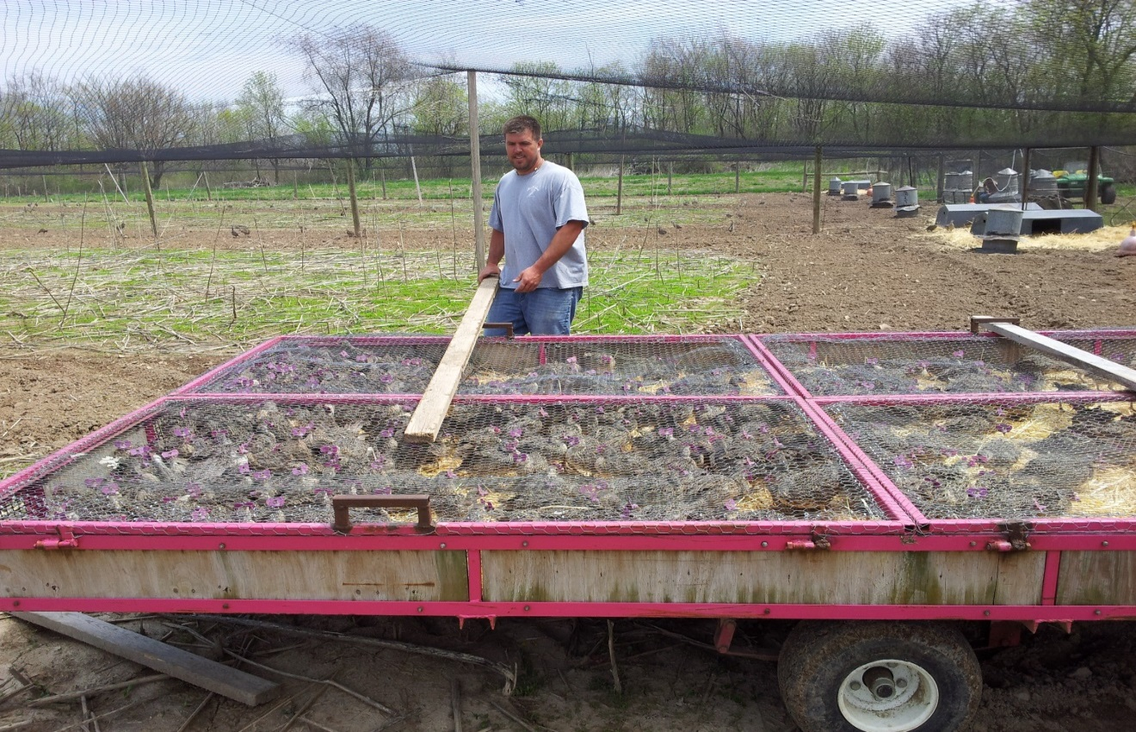
Straw on the bottom of trailer provides comfort and cleanliness

Slide 11
Correct any sexing errors

Slide 13
Moving out French is done with crates

Slide 14
Handy tool on a pheasant farm

Slide 15
Birds caught and stacked ready to be loaded

Slide 17
Loading semi for relocation

Slide 18
Off to South Dakota farm

Slide 19
Shipping Season – Prepping for the next day

Slide 20
This is why we sex at moveout

Slide 21
Somethings are black and white

Slide 22
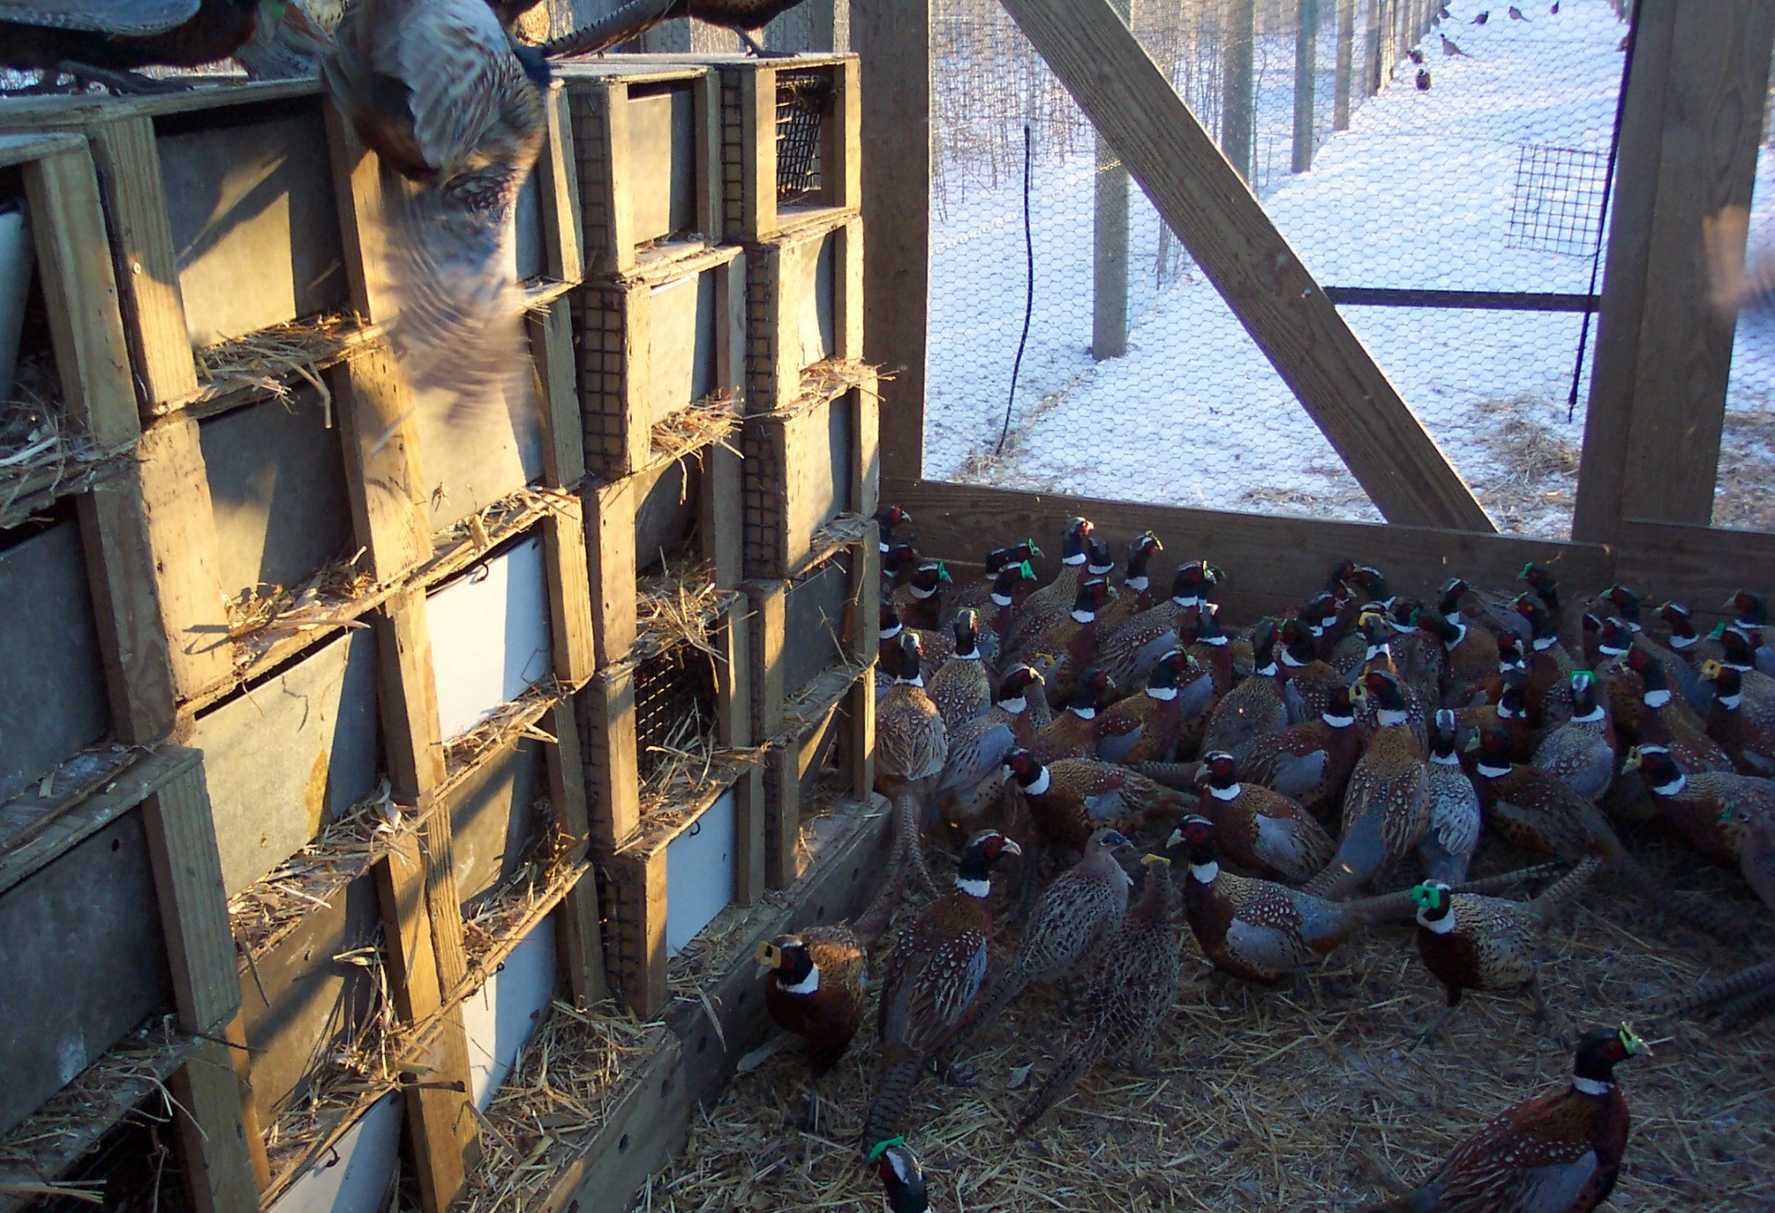
Crates are placed and bedded the day before

Slide 23
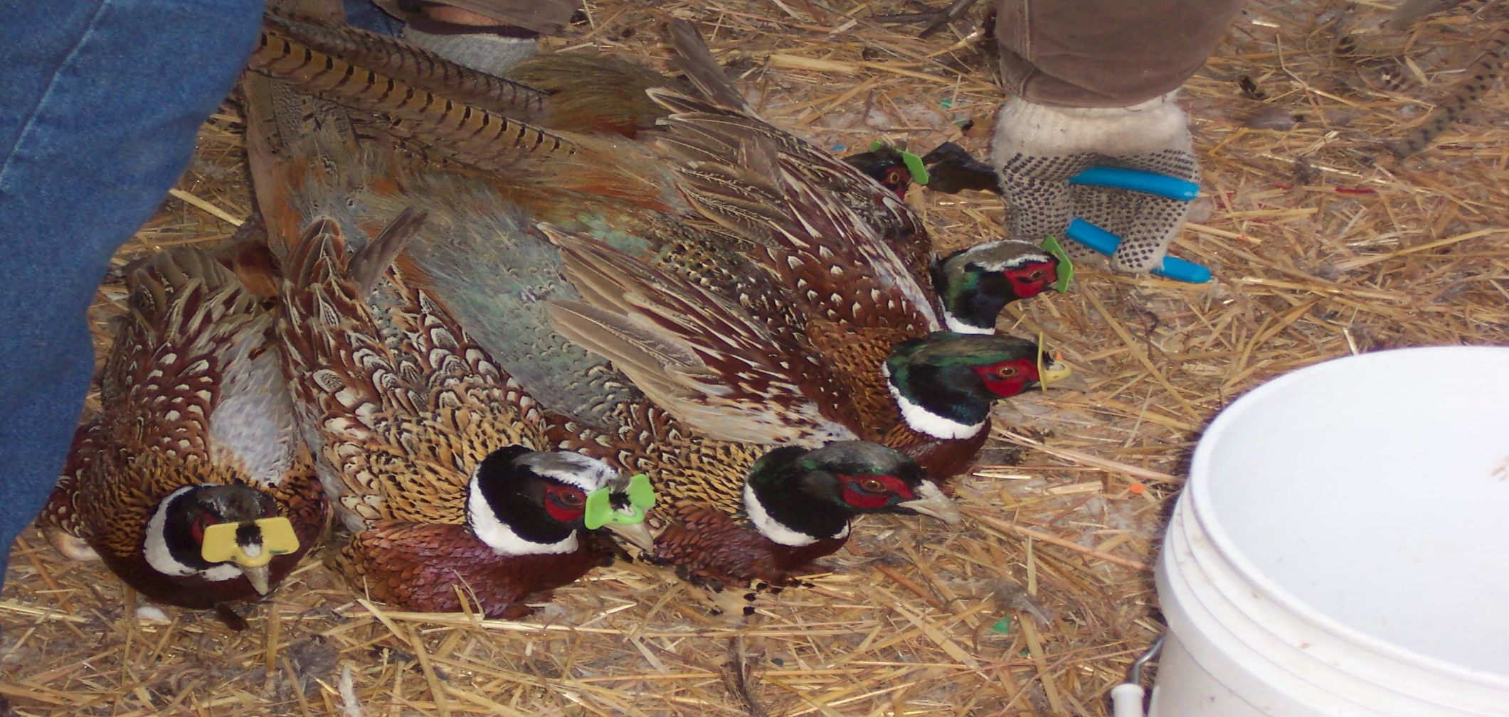

Slide 24
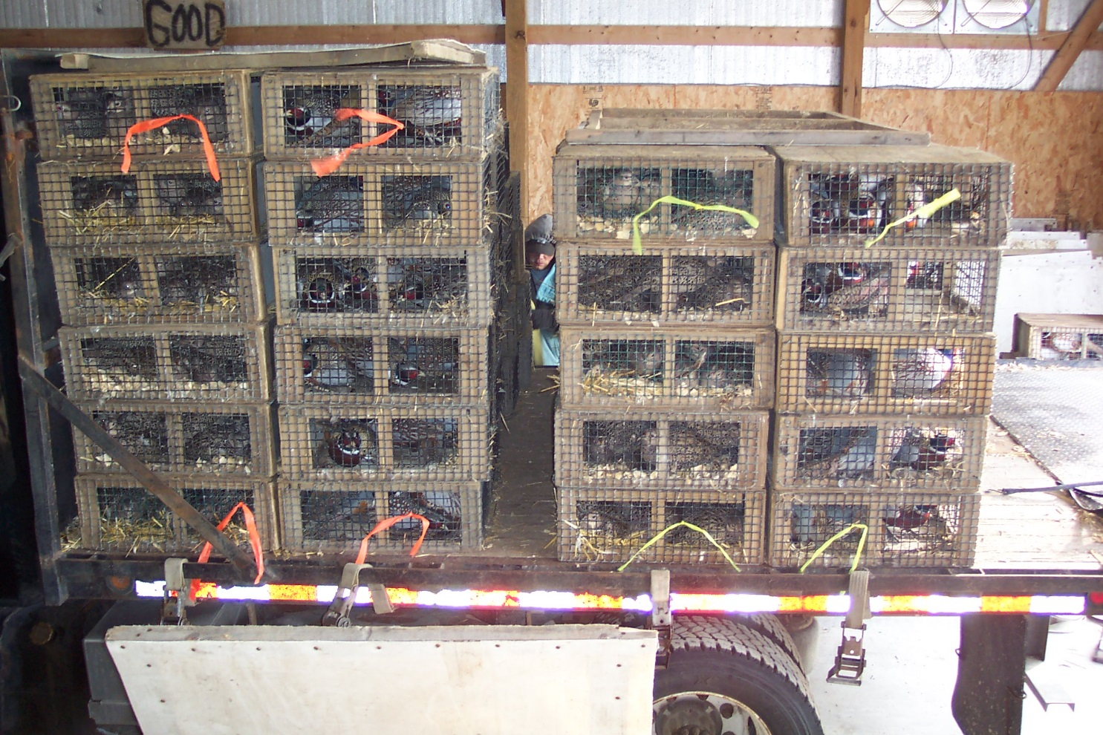
Multiple customers or different breeds – flagged for I.D.

Slide 25
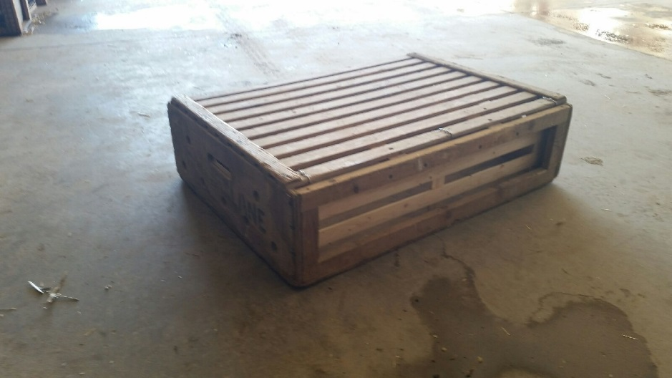
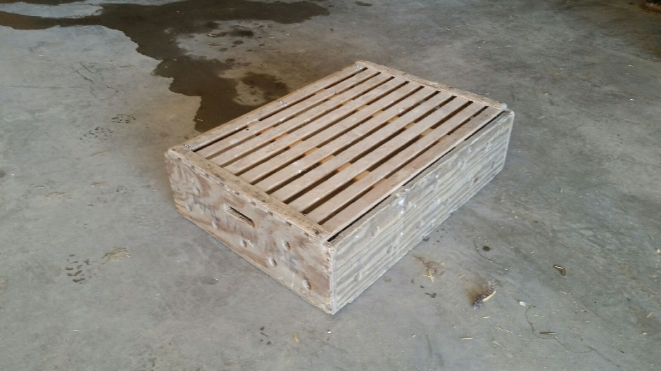
Big crates
Dimensions are 24x32x9
Can accommodate (only cox)
10-12 RN cox
8 White cox
10 MM cox

Slide 26
Temps and number per crate

Slide 27
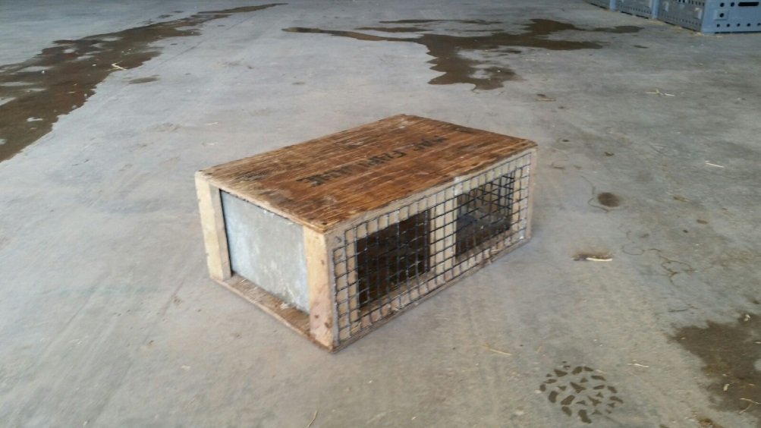
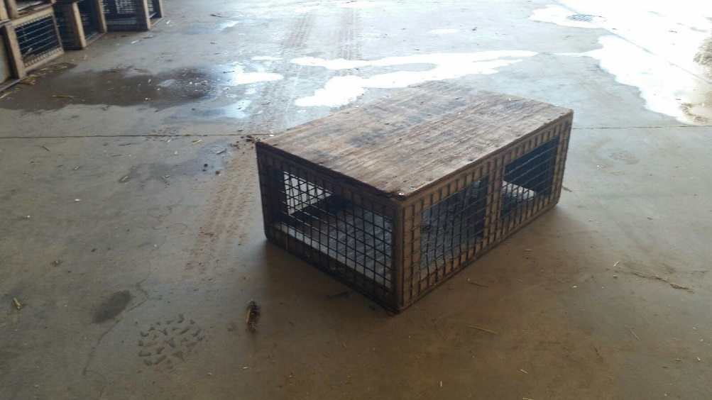
Small crates
-Dimensions are 24x16x9
-Can accommodate
5 RN cox
8-10 RN hens
15 huns
15 chukar
4 Whites
5 Mut cox
8 Mut hens

Slide 29
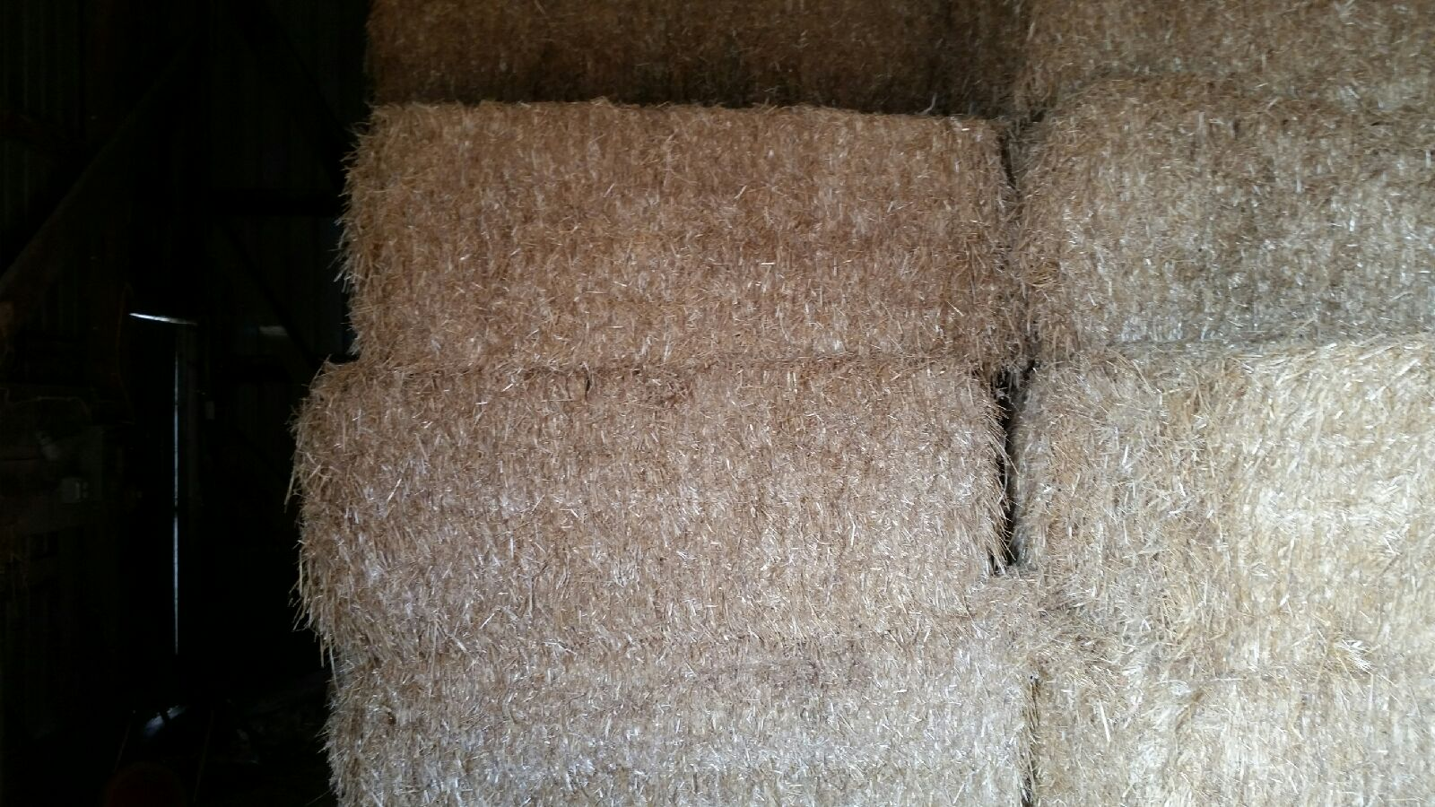
Crates are typically bedded with straw

Slide 30
Wood chips
We use these for a few specific customers if allergic to straw and when it’s raining to keep from having tails tie together

Slide 31
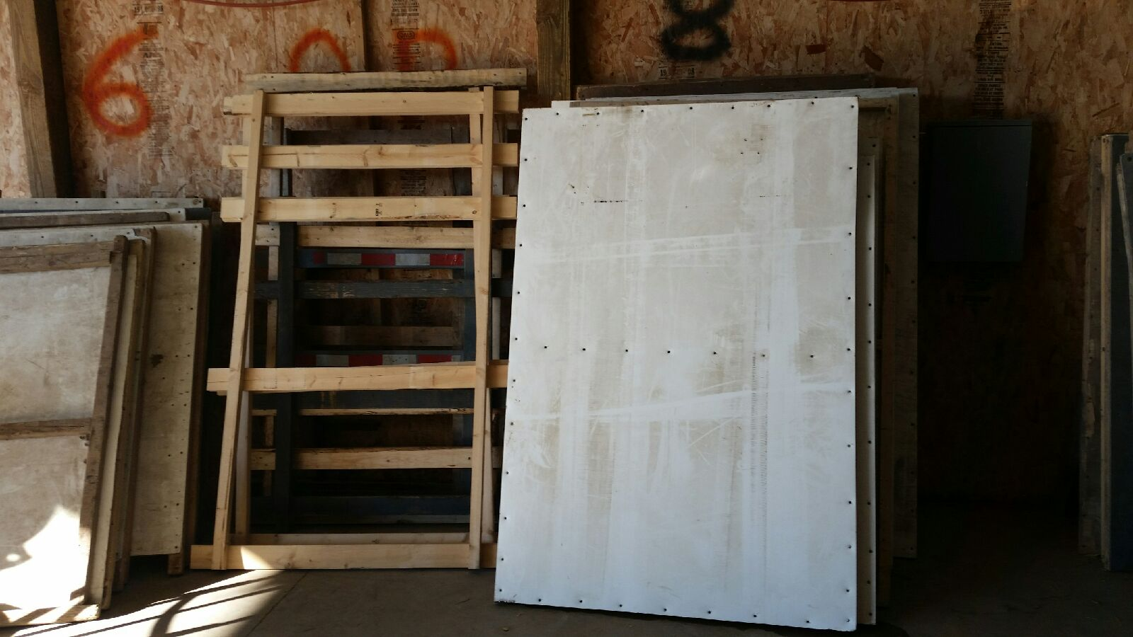
Sides
At MacFarlane we use two different types of sides. The ones on the left are “open sides” used with our big crates to secure the load and keep the integrity of the section. The ones on the right are “closed sides” used with our small crates for the same reasons along with protecting the birds from exposure.

Slide 32
Before sides are added

Slide 33
Complete load

Slide 34
Tarp

Slide 35
Local deliveries

Slide 37
Putting up and taking down

Slide 38
Work hard & Play hard

