Slide 1
Using Diagnostic Laboratories Effectively
David D. Frame, DVM, DACPV
Utah State University Extension Poultry Specialist

Slide 2
Selection of Samples
Select only fresh mortality (recently picked up). Dead no longer than 12 hours – less if hot weather.
Select only representative samples of the problem occurring.
Anticipate sending at least five (5) birds.
Refrigerate but do not freeze.

Slide 3
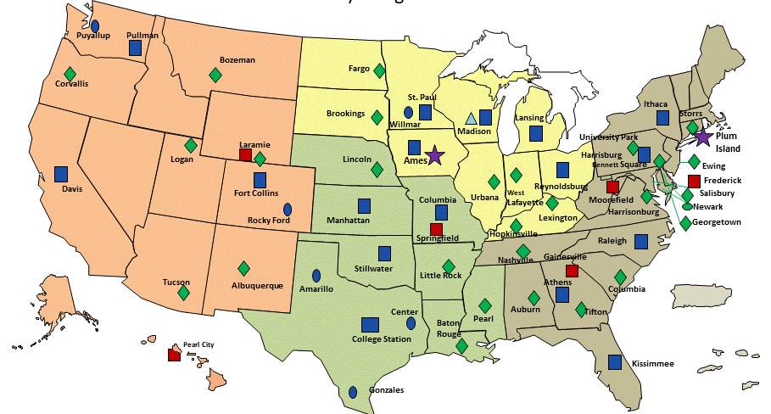
Where to ship
Identify a poultry diagnostic laboratory near you.
Distant laboratories may charge additional “out-of-state” fees.
Call before sending anything.
National Animal Health Laboratory Network (NAHLN)

Slide 4
Packaging
Double-bag everything.
Use Styrofoam inner container within a cardboard box outer shell.
Use artificial ice to keep specimens cool during transport.
Pack with newspaper or other shock-absorbant, moisture-wicking material.
Place submission form in a waterproof ziplock bag. Tape to top of Styrofoam inner container.
Attach appropriate outer mailing label – print legibly and use accurate shipping destination address.

Slide 5
Packaging
Diagnostic substances designation
Label must be marked on the outer package.
Minimum label dimensions: 50 mm (2 inches) on a side, and the proper shipping name, “Biological Substance, Category B” must be in letters at least 6 mm (1/4 inch) high).
A Shipper’s Declaration is NOT required. If applicable, the text “Biological Substance, Category B” and “UN 3373” should be documented on the waybill.
Printable labels can be found online

Slide 6
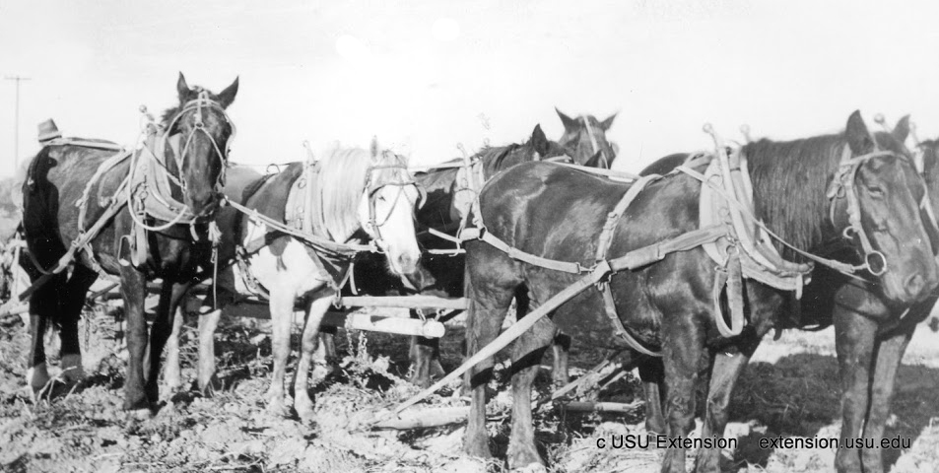
When to ship
Try to ship on a Monday or Tuesday if possible.
Not on a Friday or weekend.
Ship “overnight” only.

Slide 7
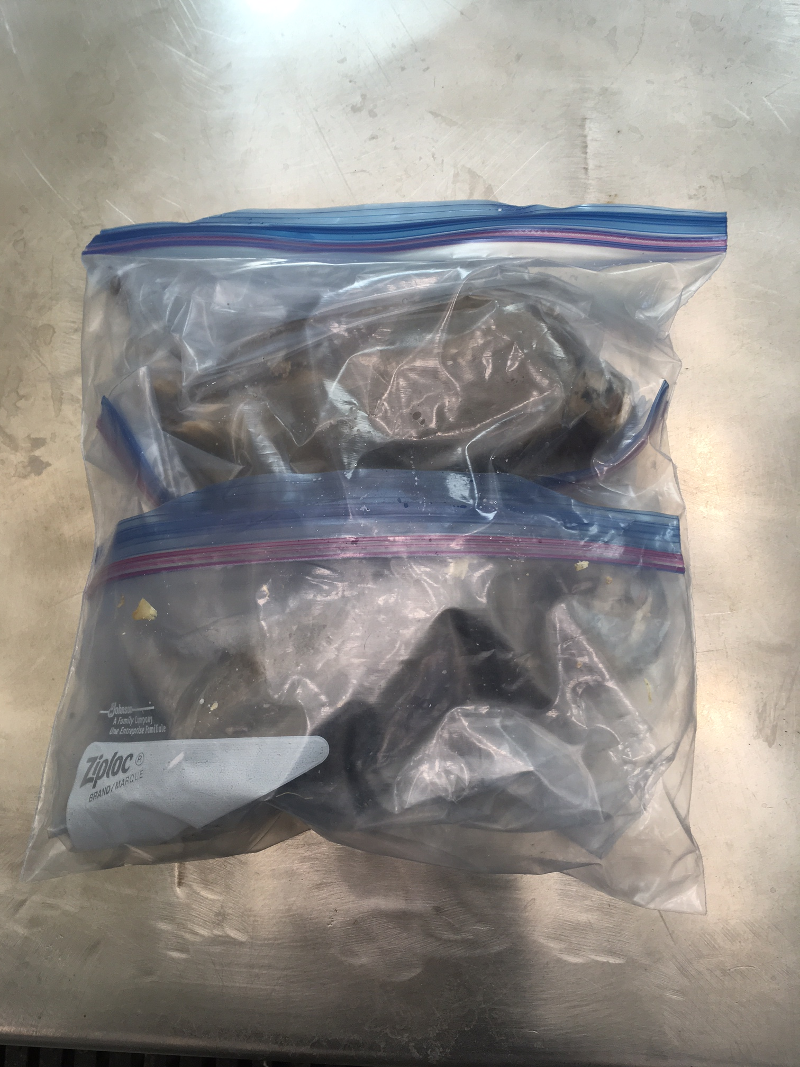

Slide 8
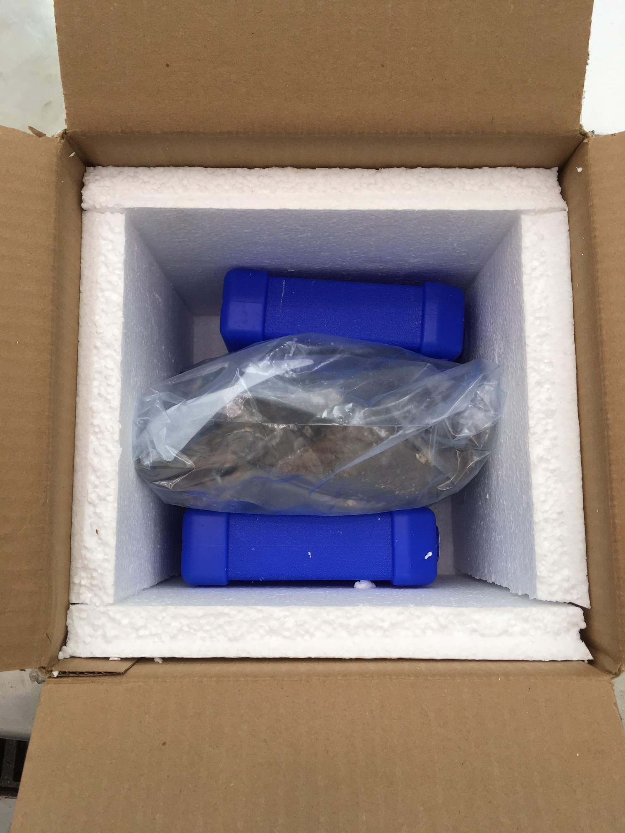
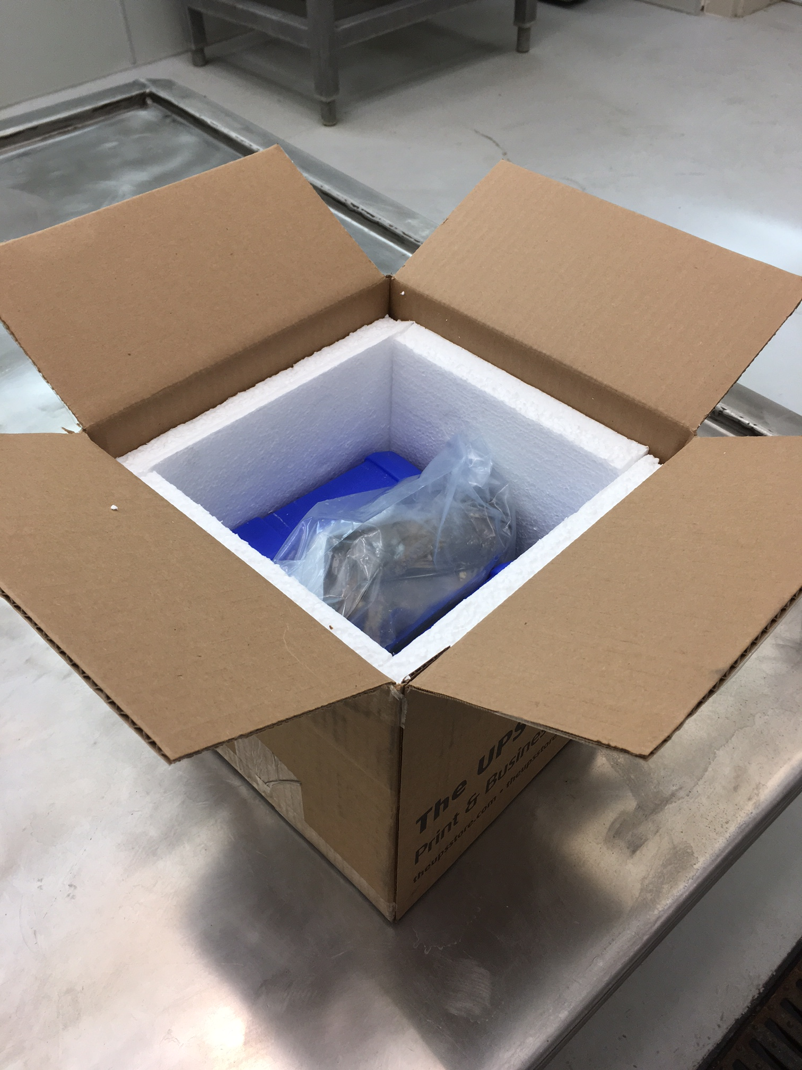

Slide 9
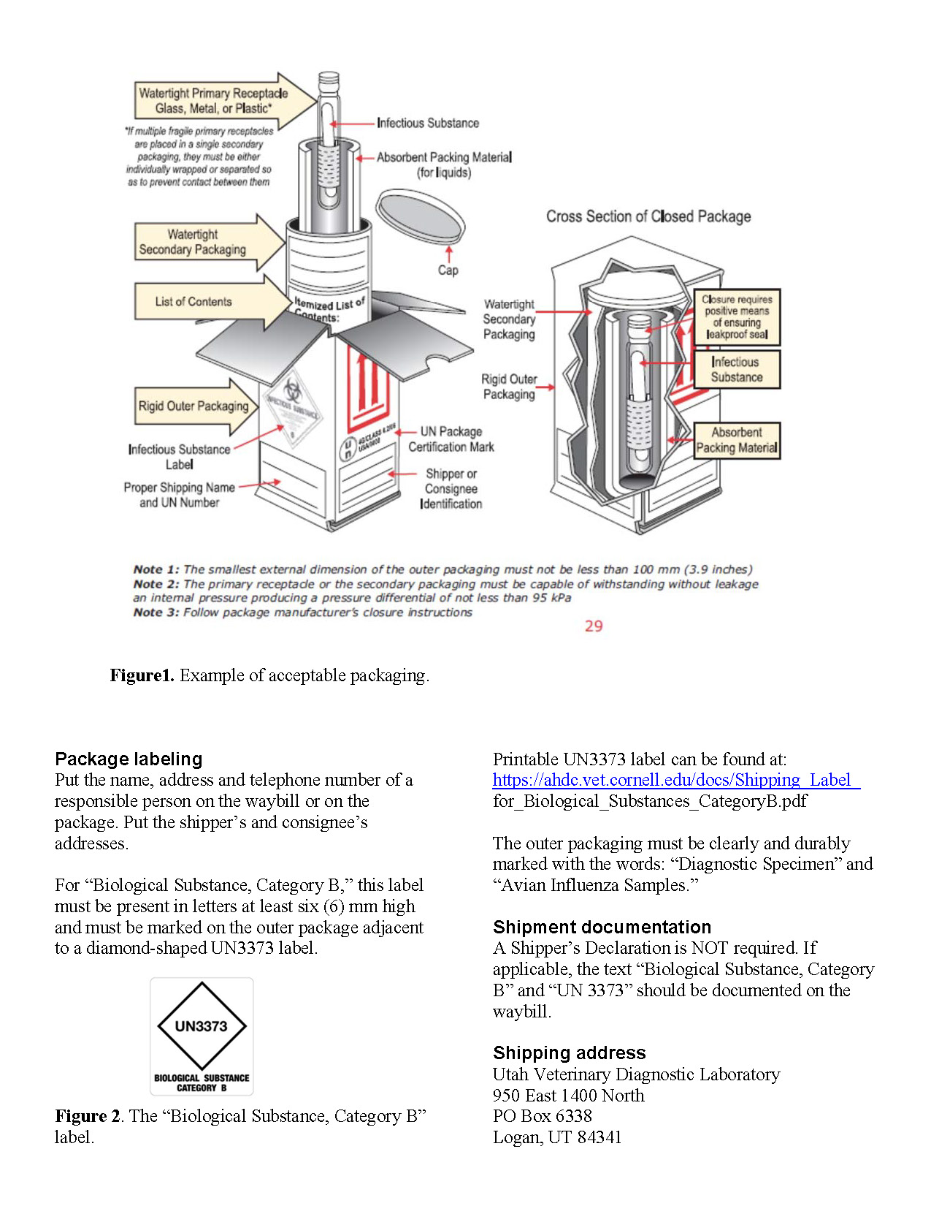
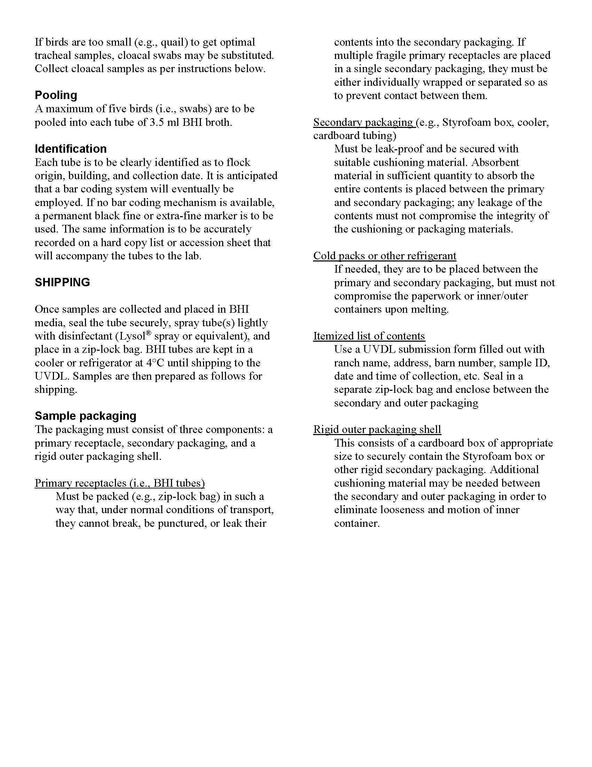
http://digitalcommons.usu.edu/cgi/viewcontent.cgi?article=1770&context=extension_curall

Slide 10
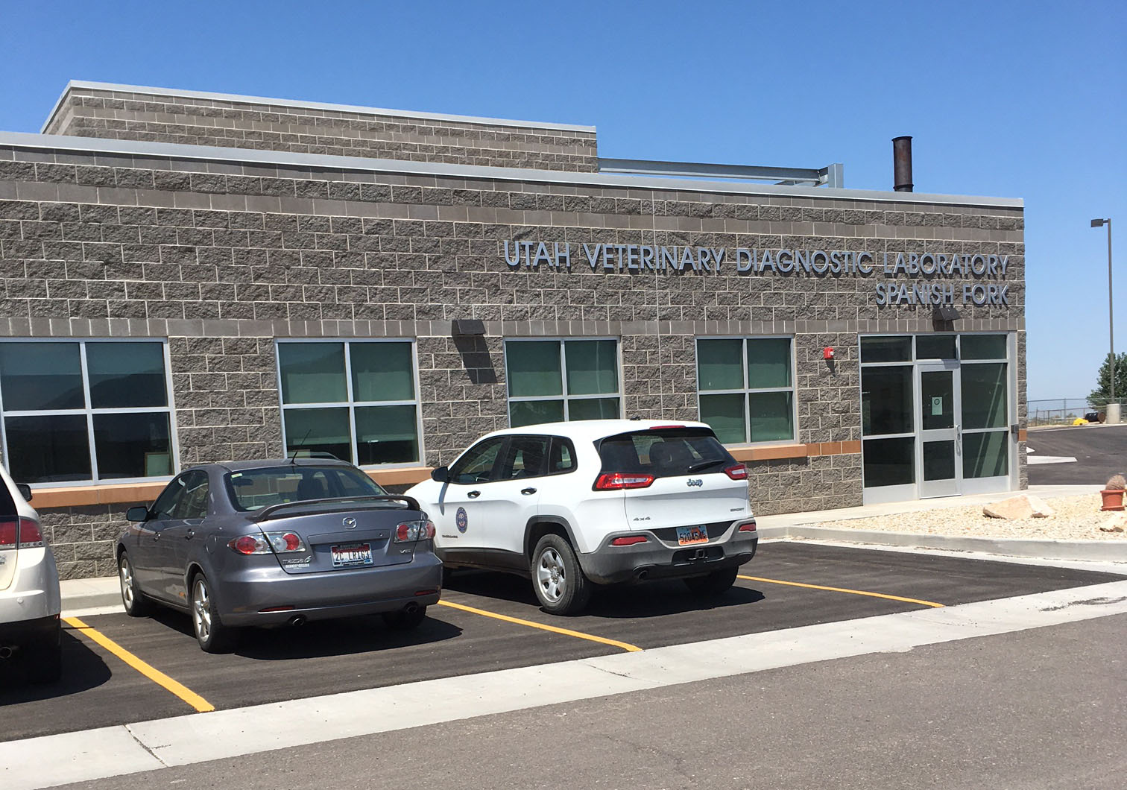
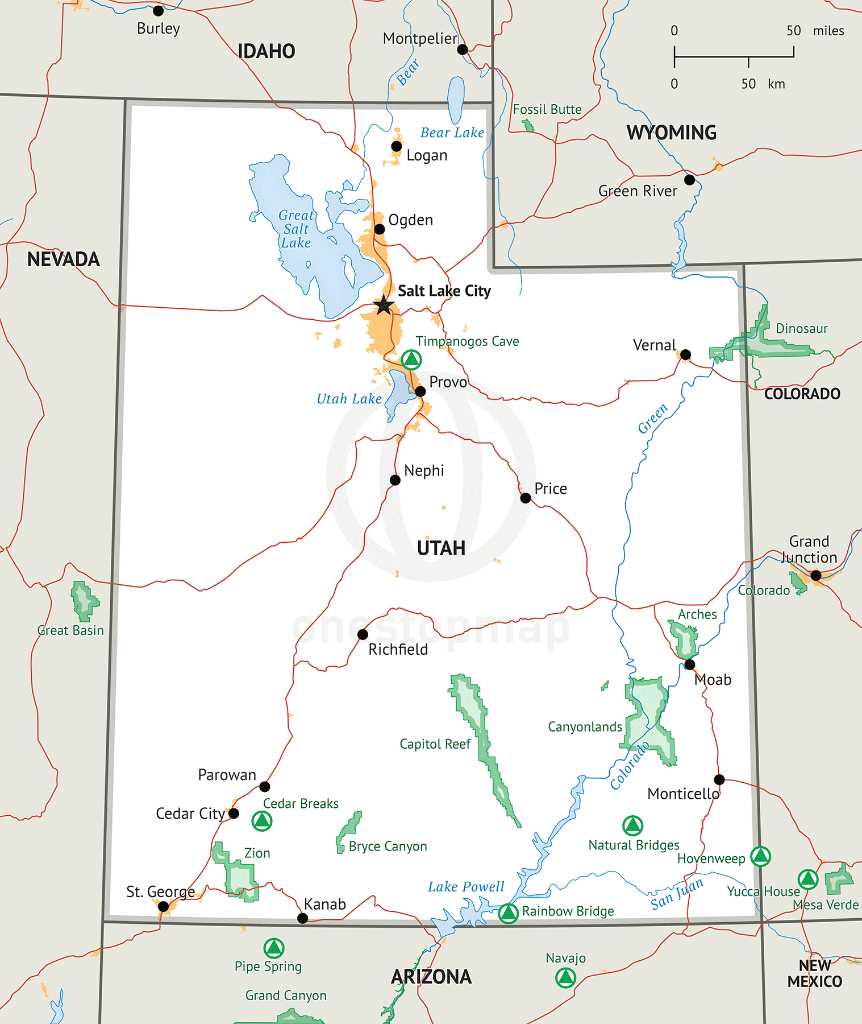
Game Bird Diagnostic Cases Submitted to the Central Utah Veterinary Diagnostic Laboratory

Slide 11
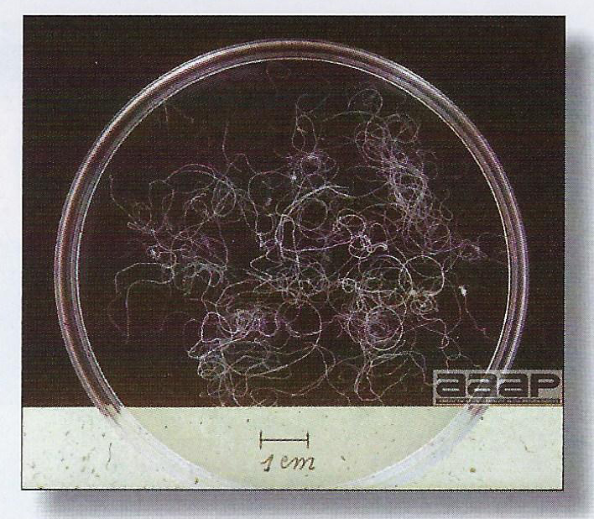
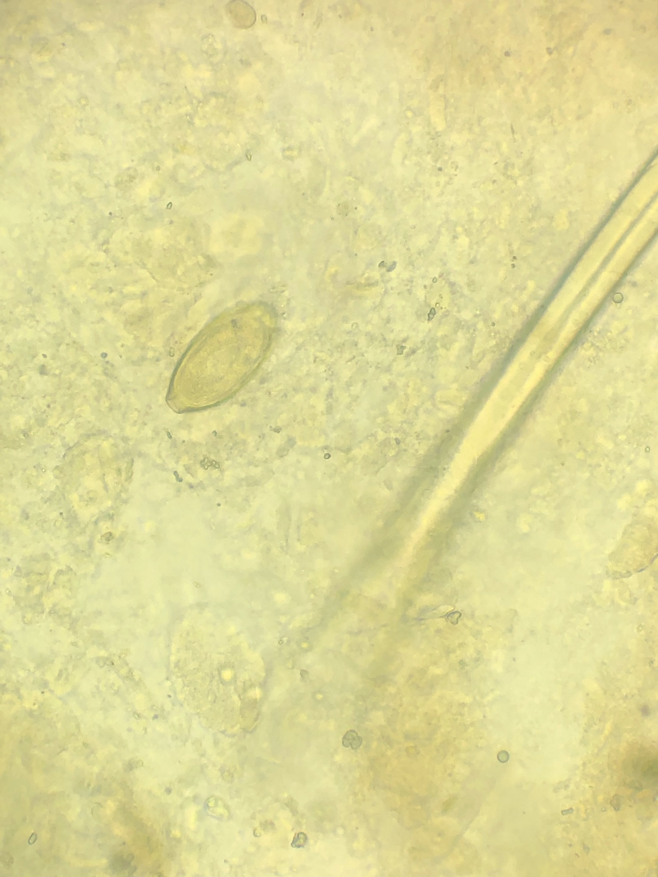
Capillaria

Slide 12
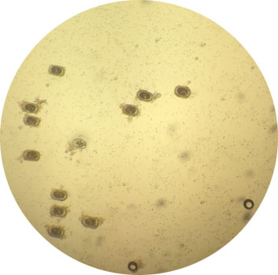
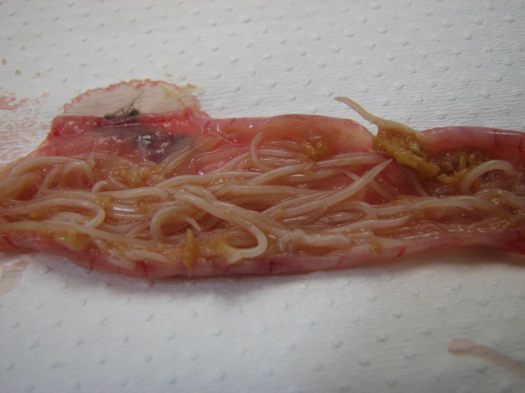
Ascarids

Slide 13
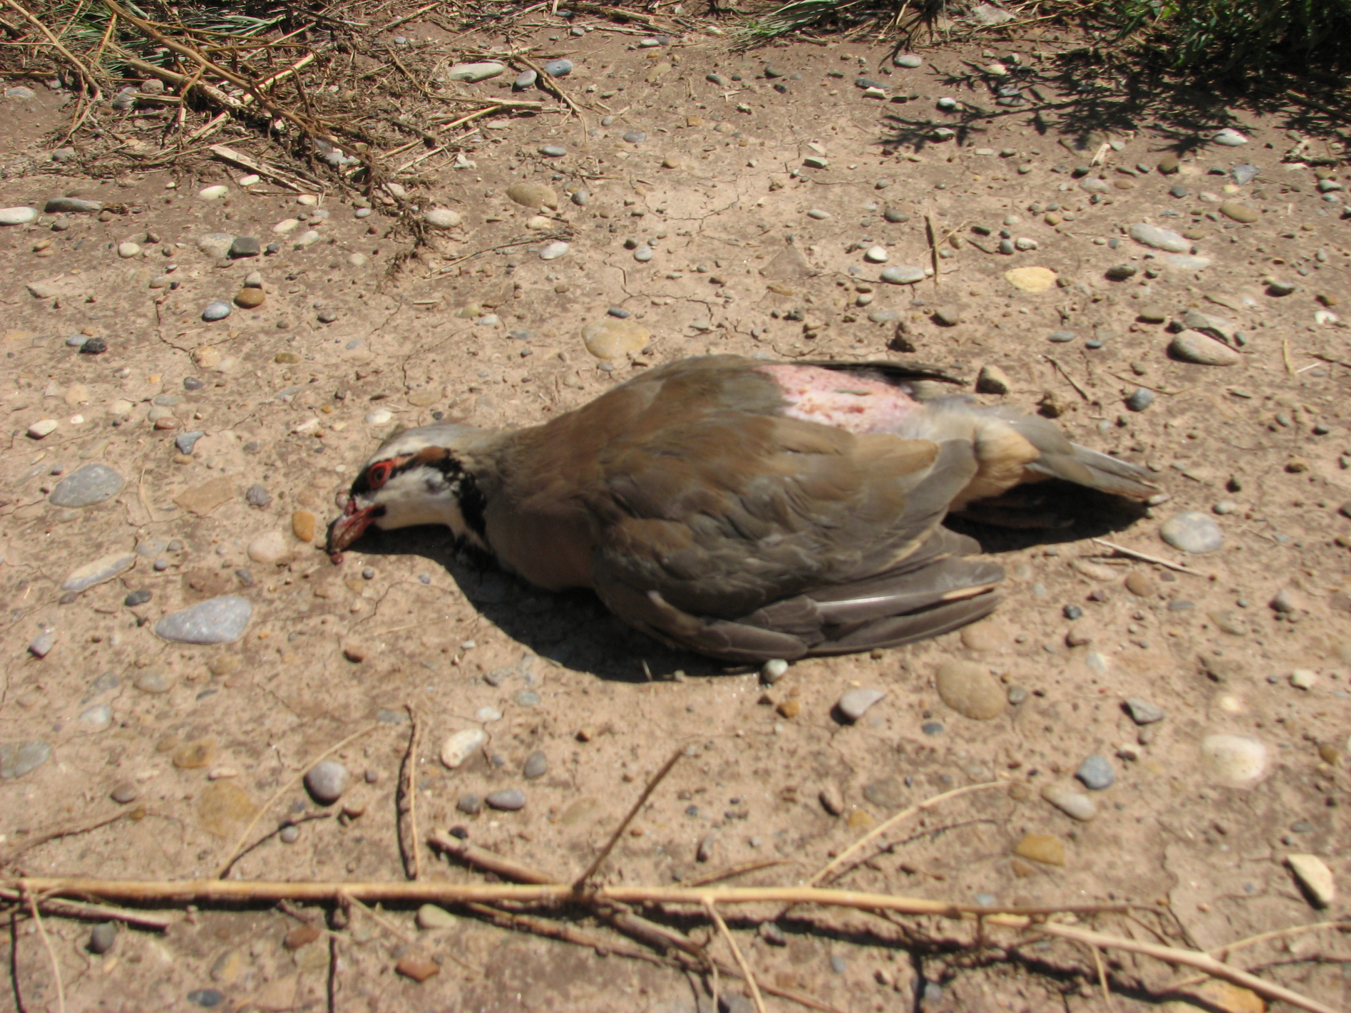
Botulism

Slide 14
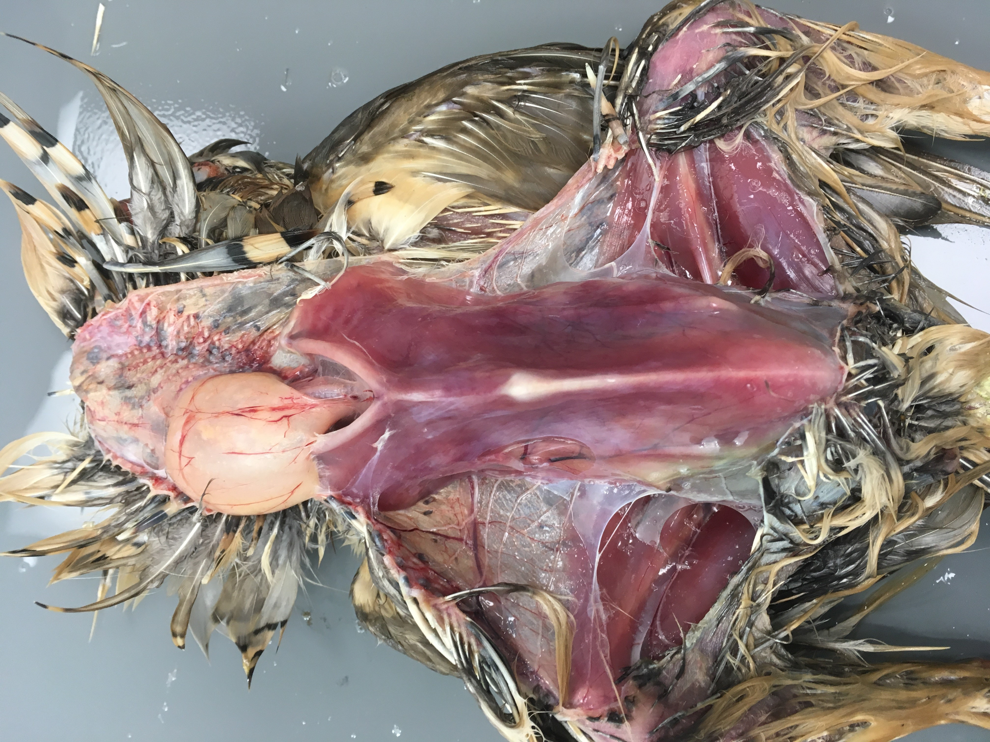
Coccidiosis

Slide 15
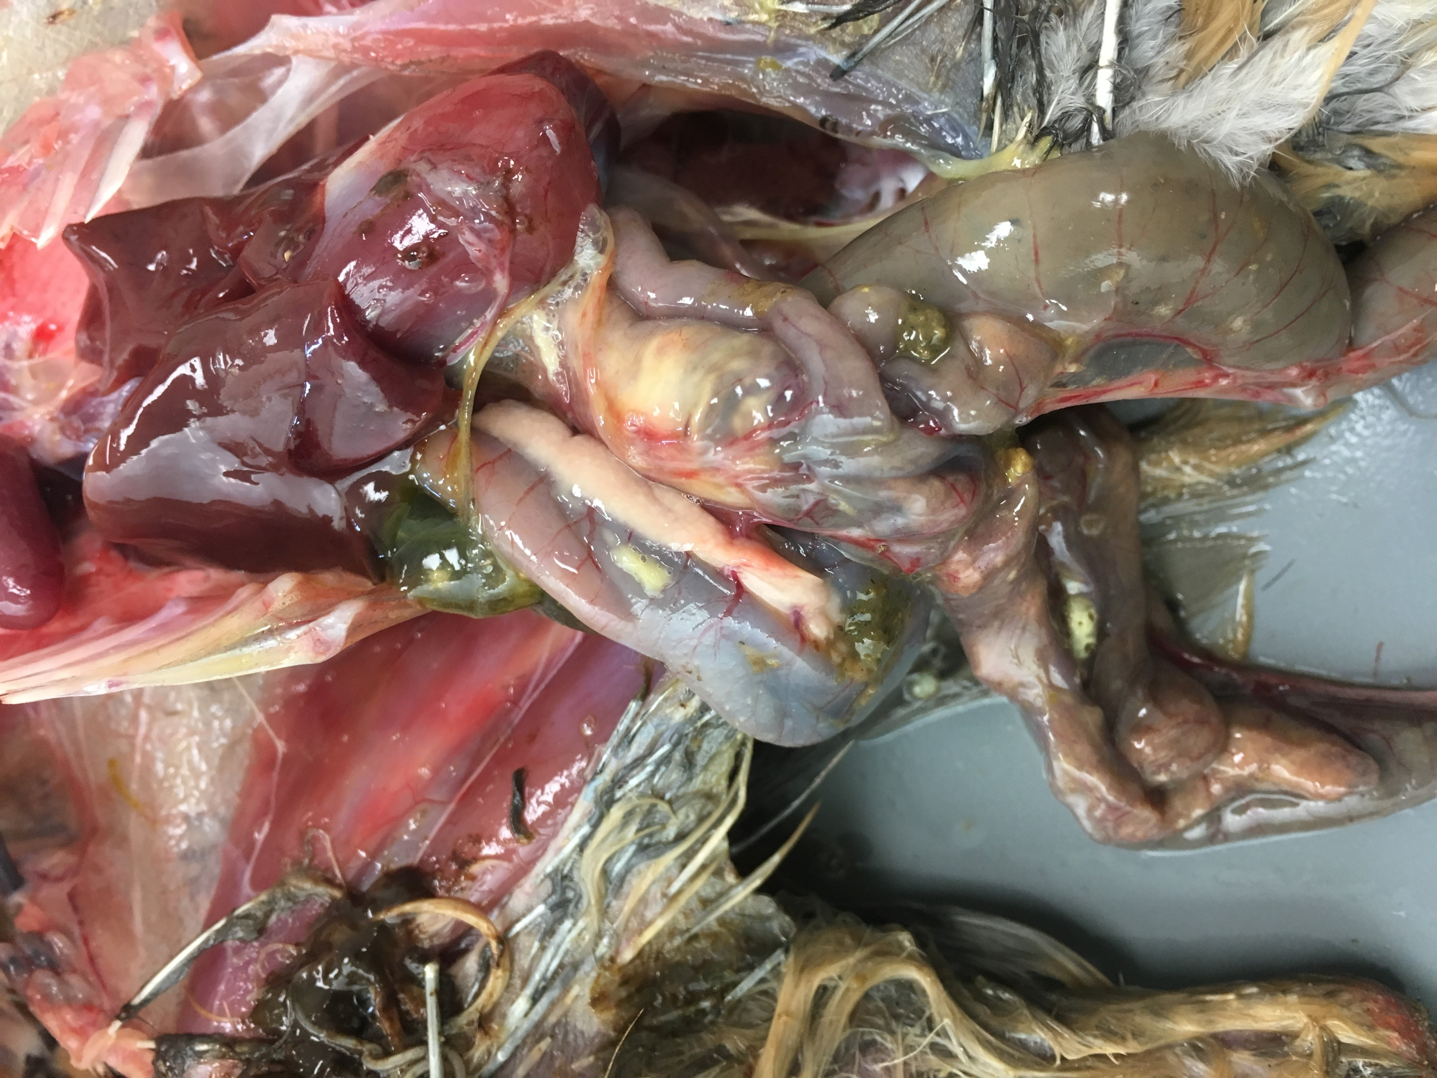

Slide 17
Fowl Cholera

Slide 18
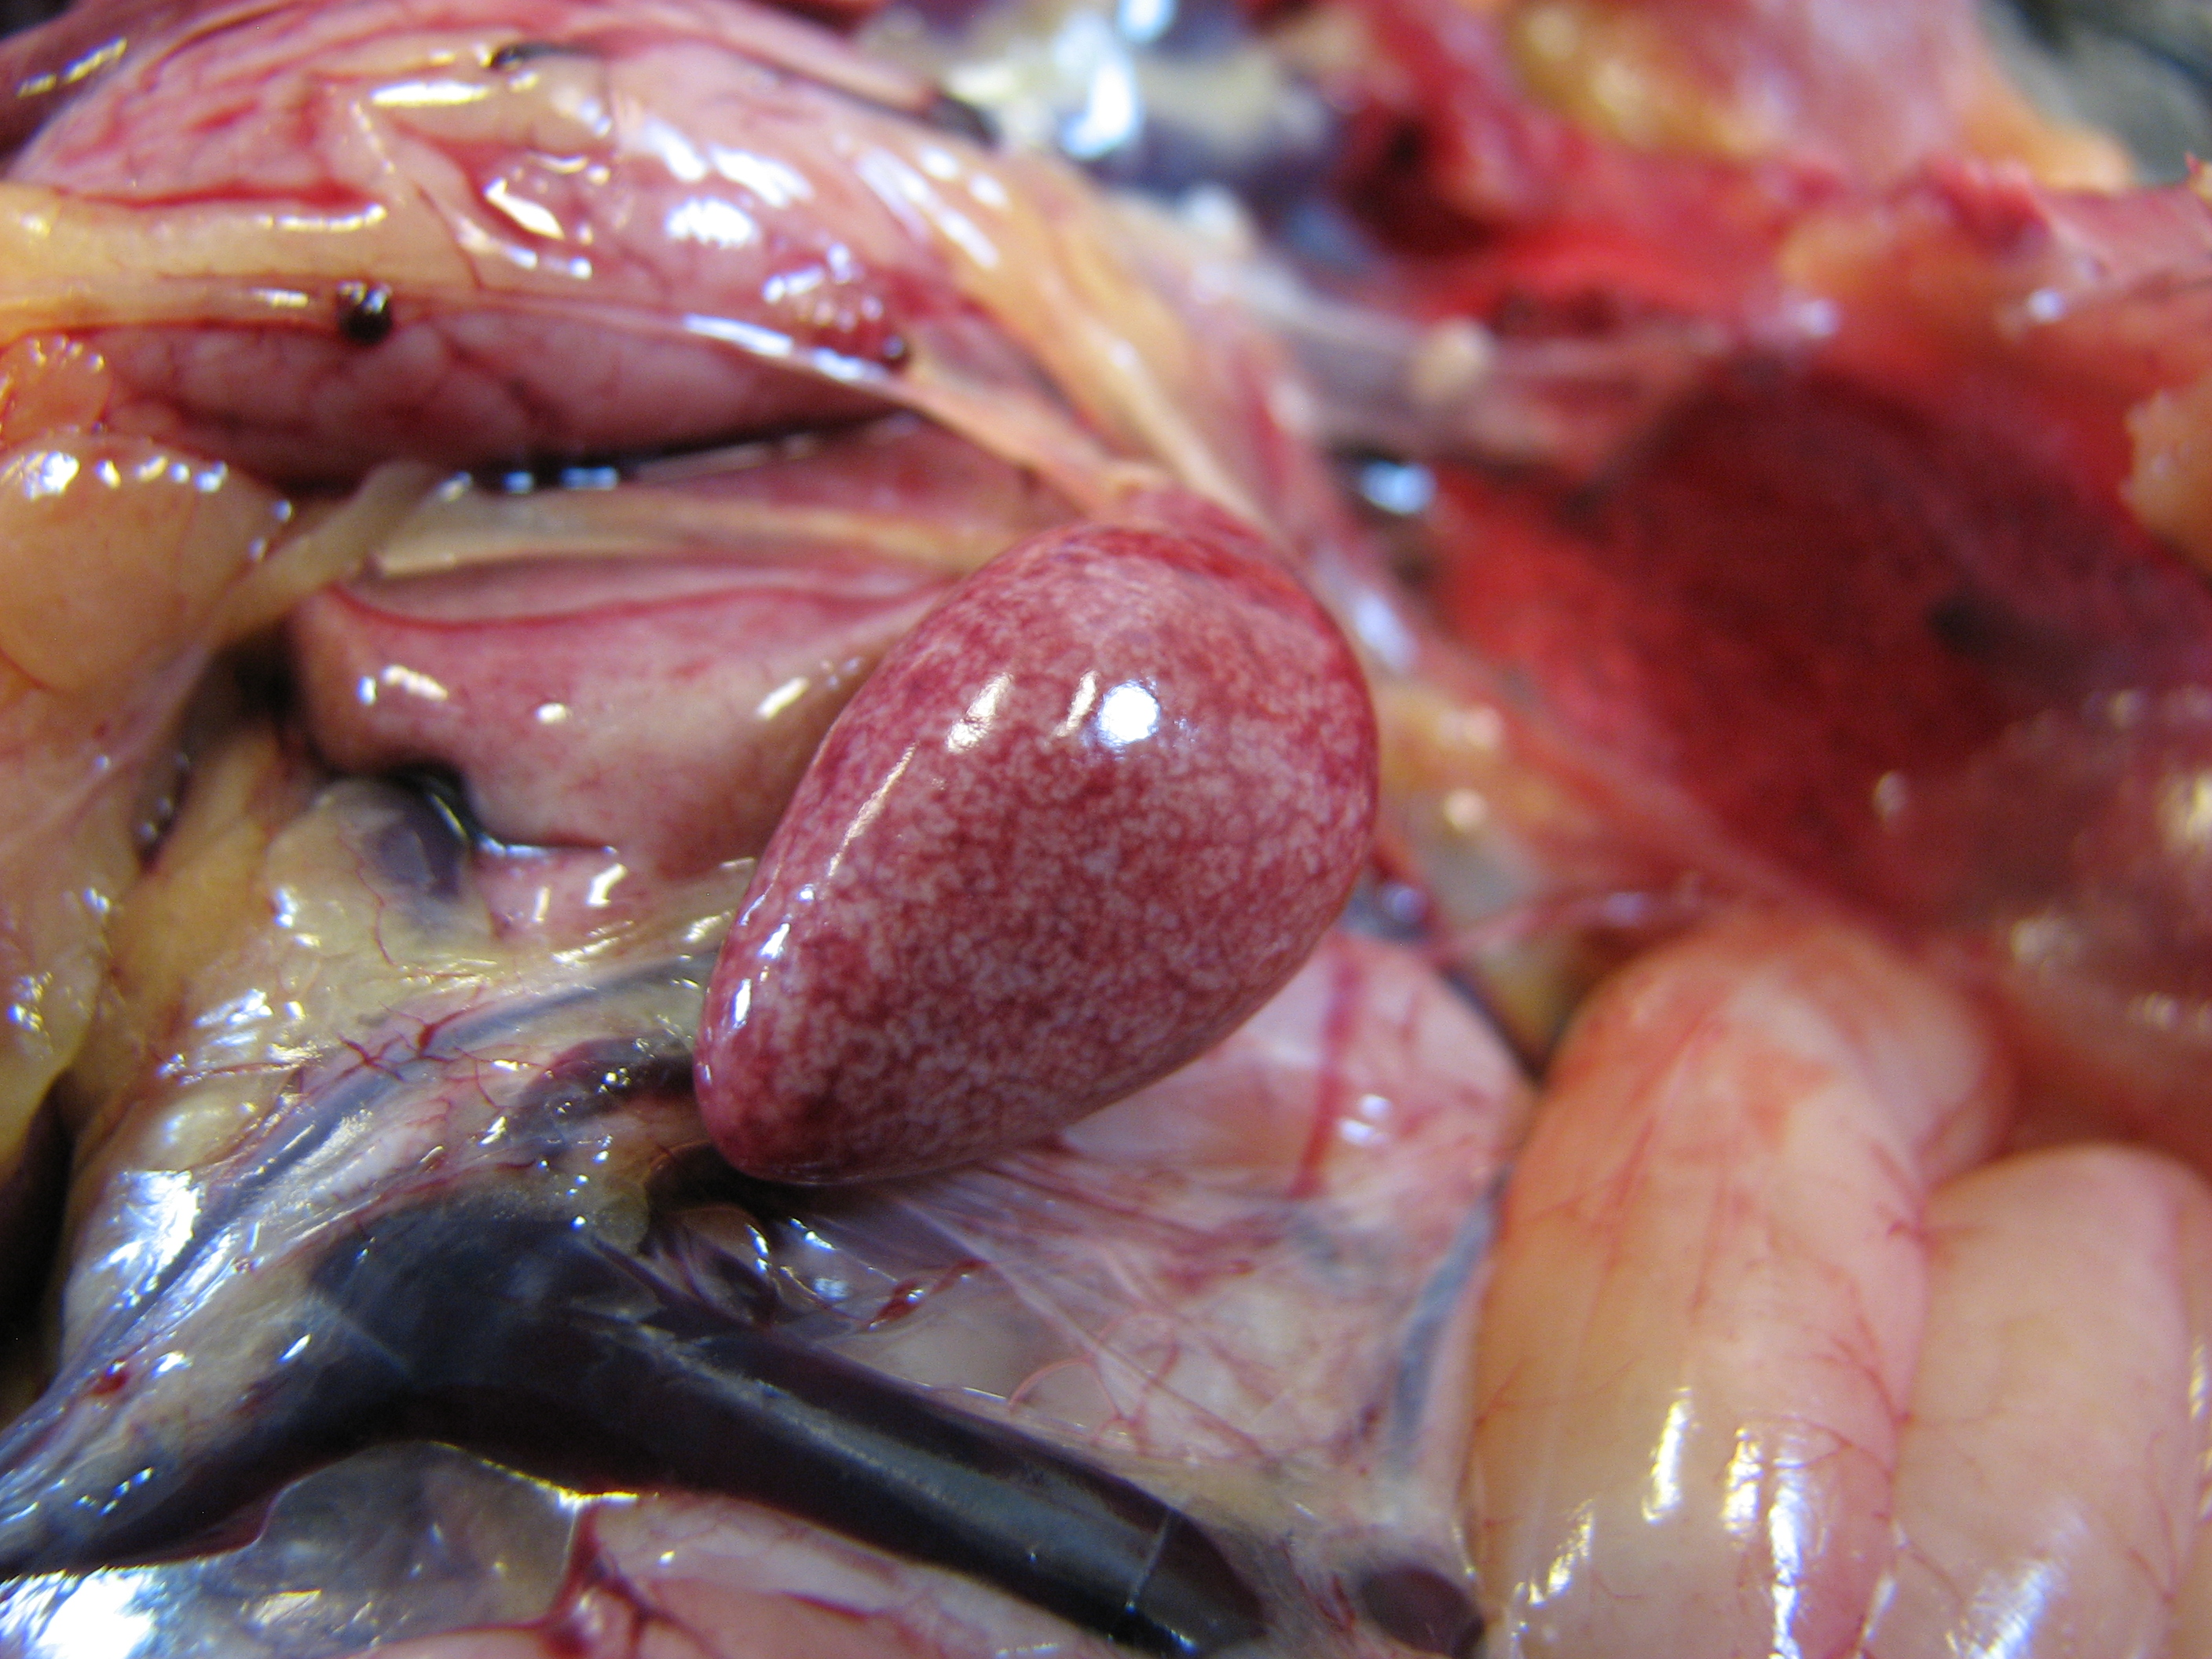
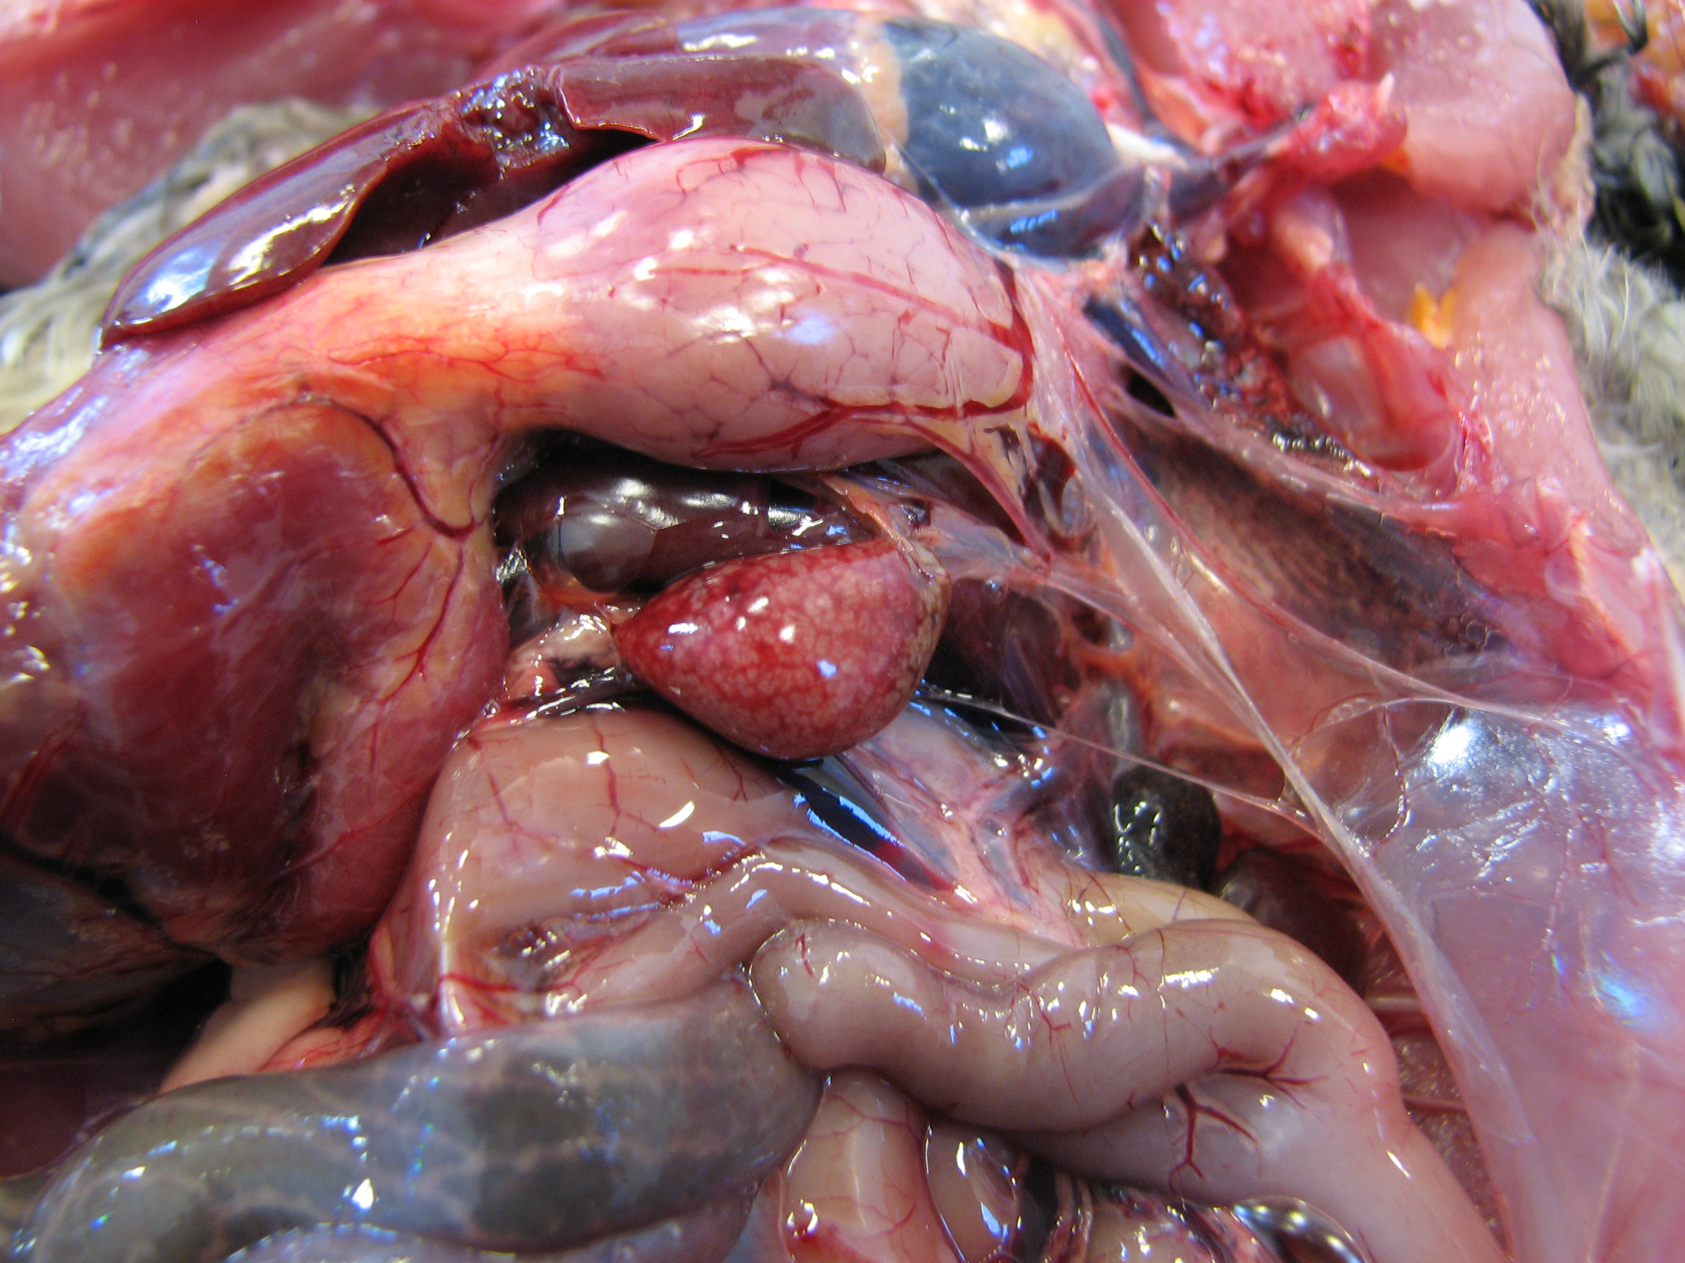

Slide 19
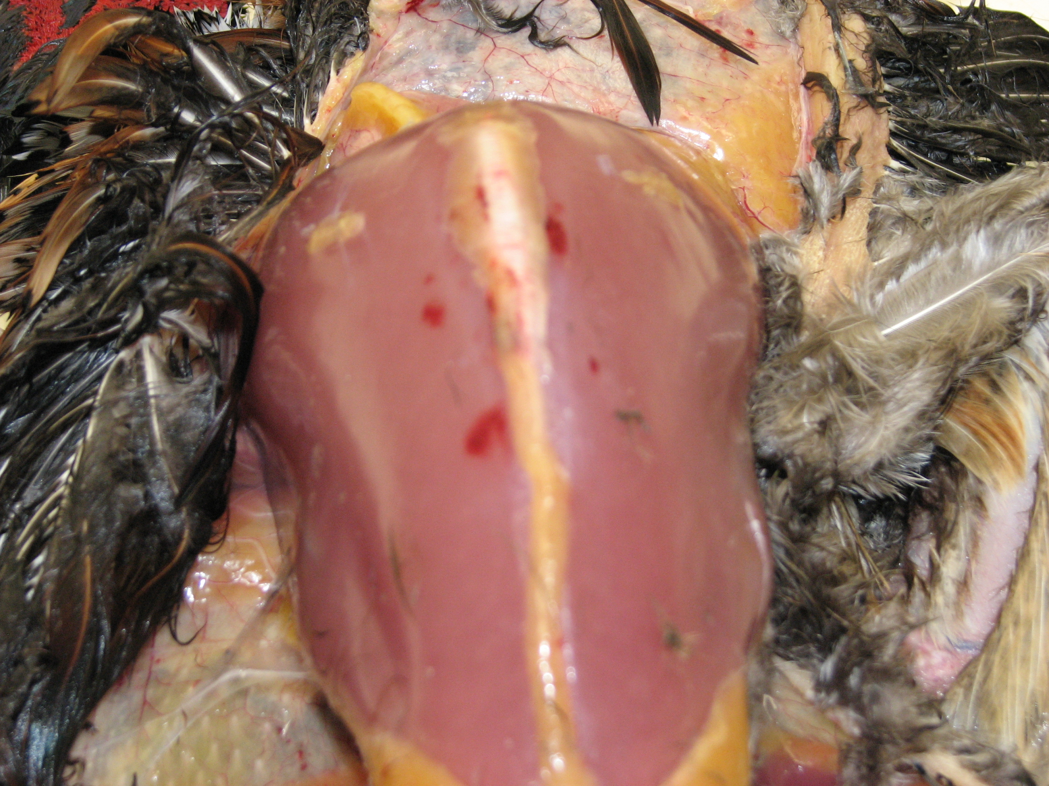

Slide 20
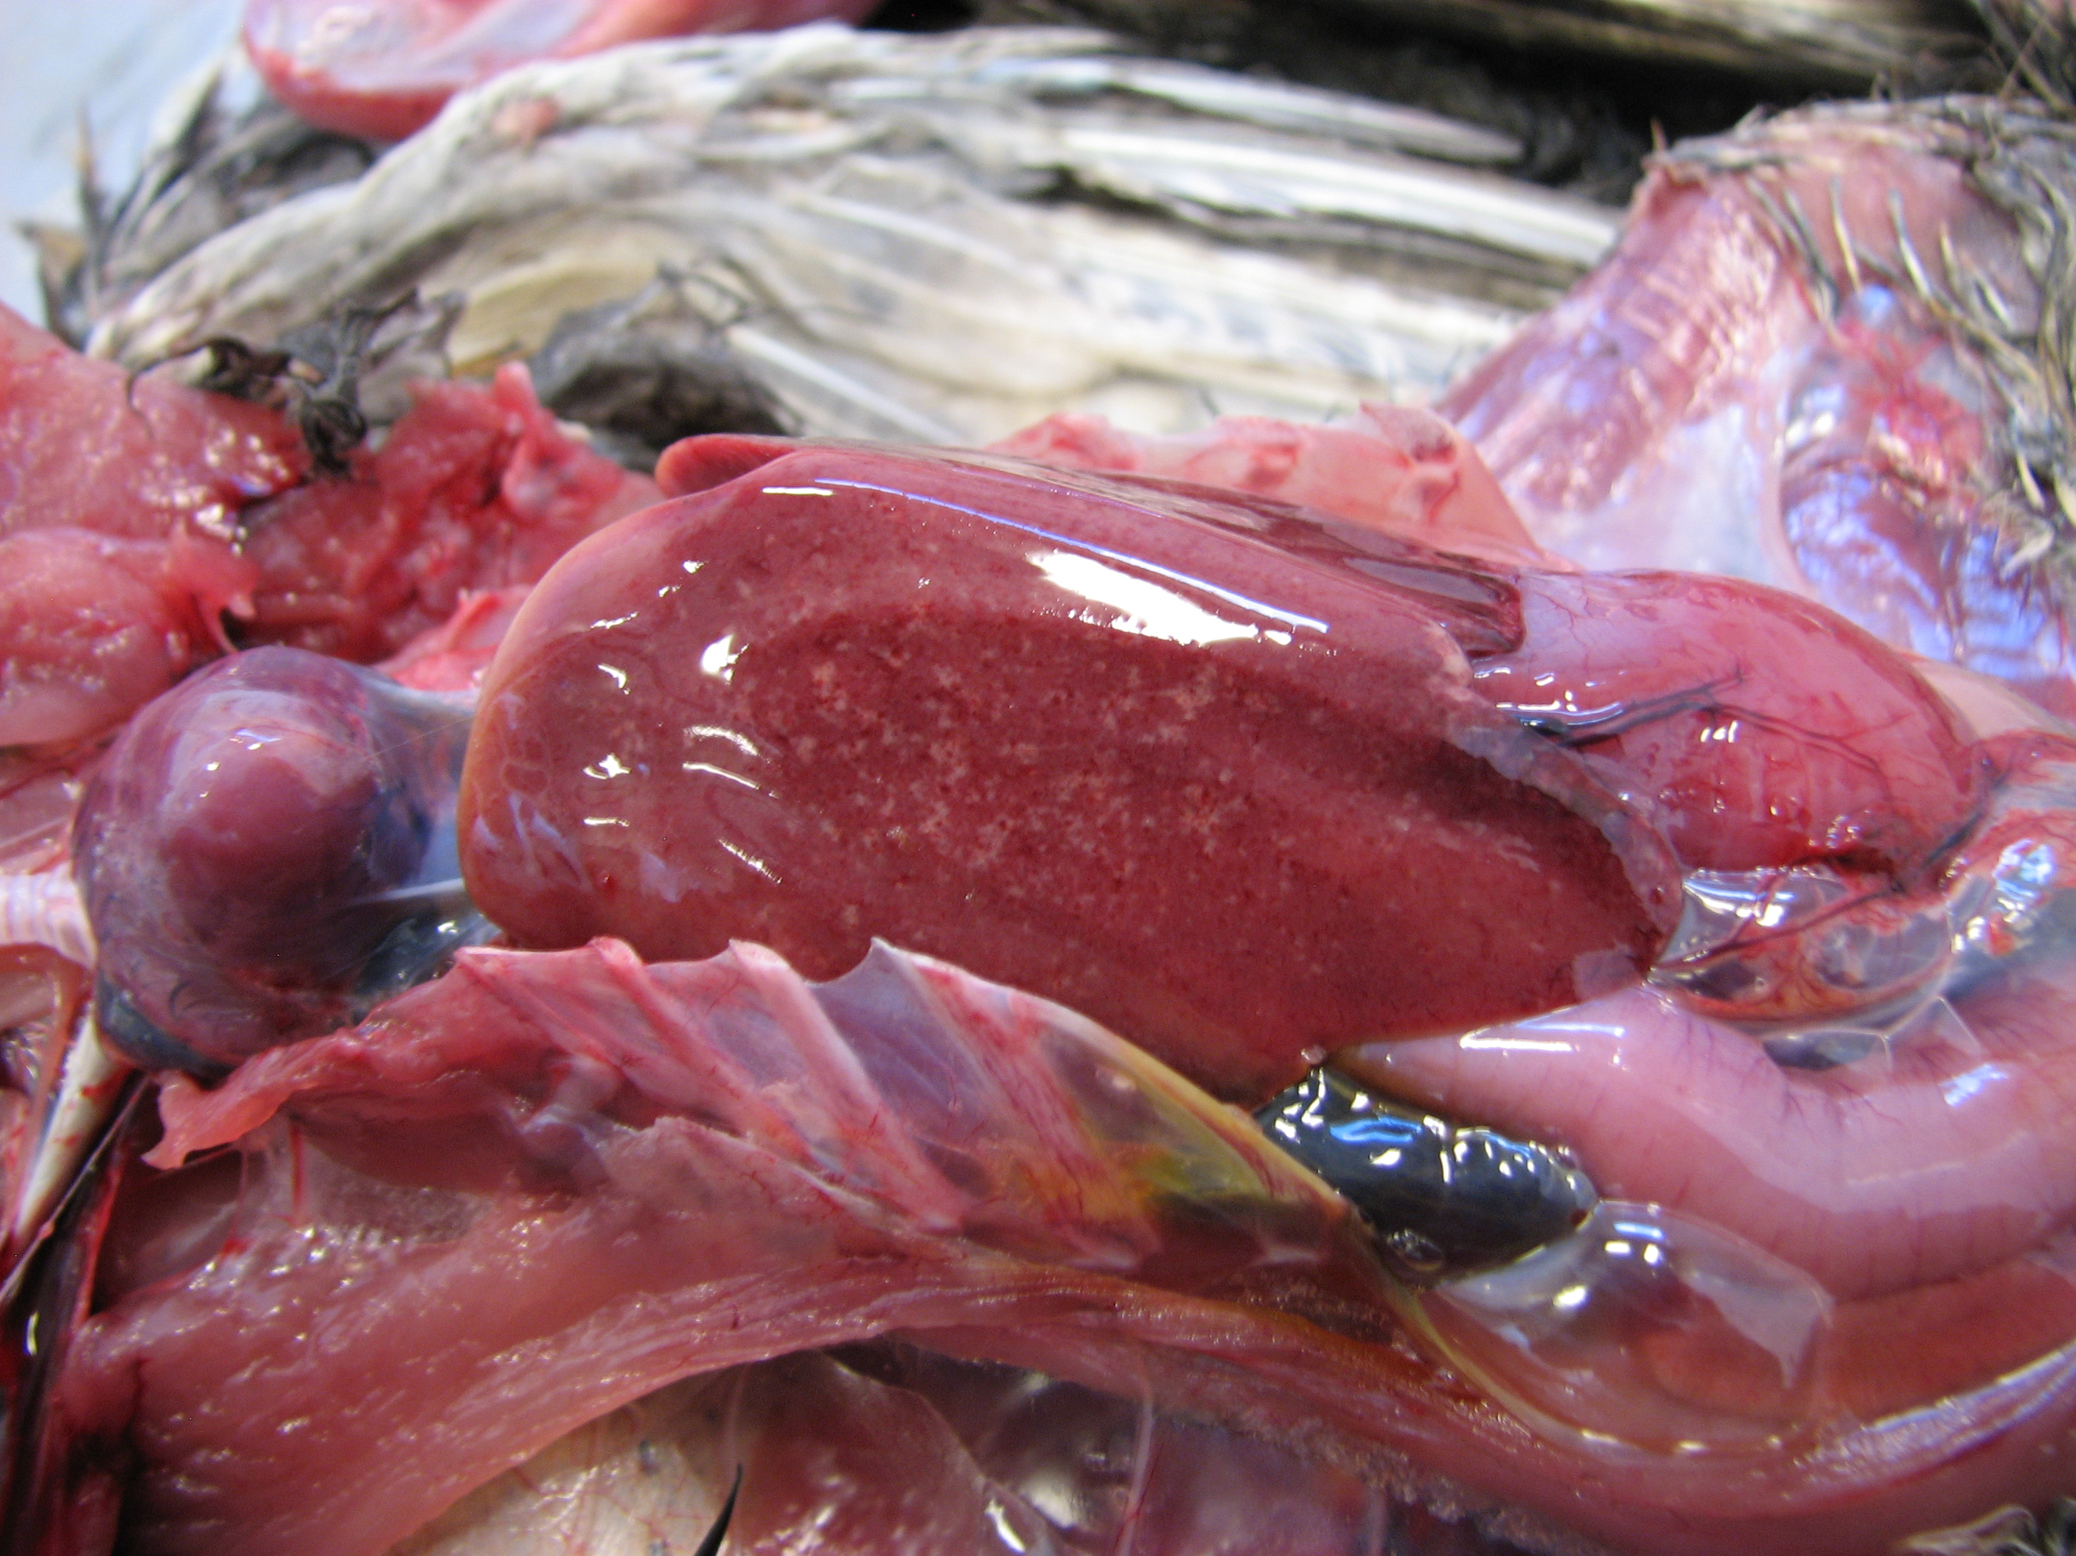

Slide 21
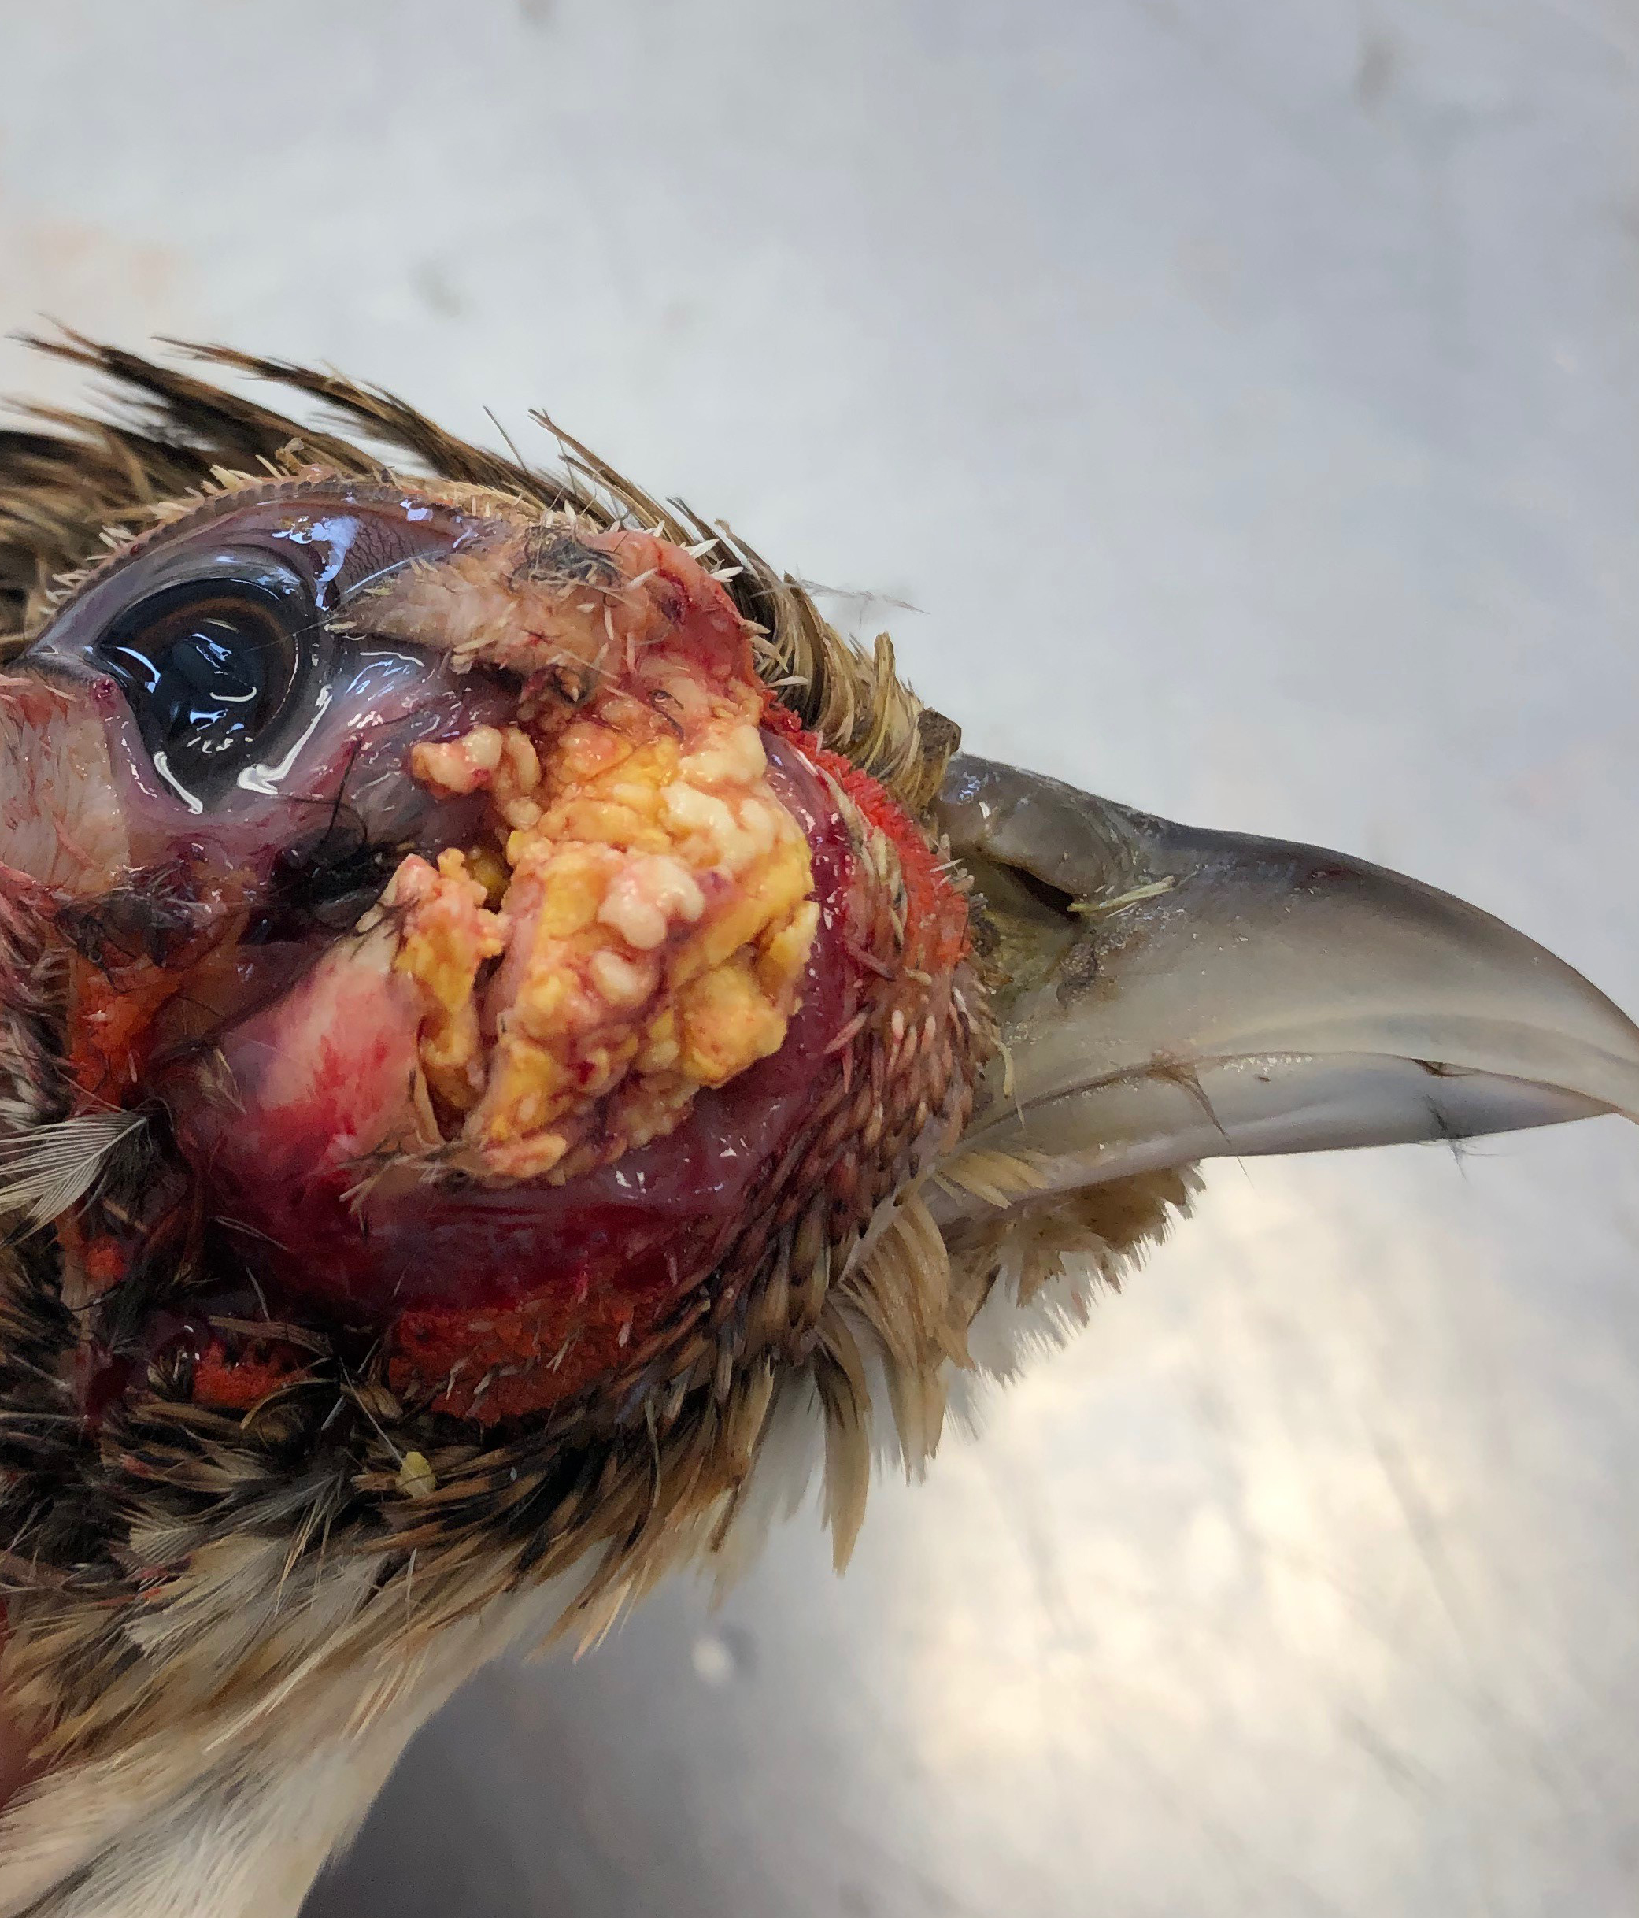

Slide 22
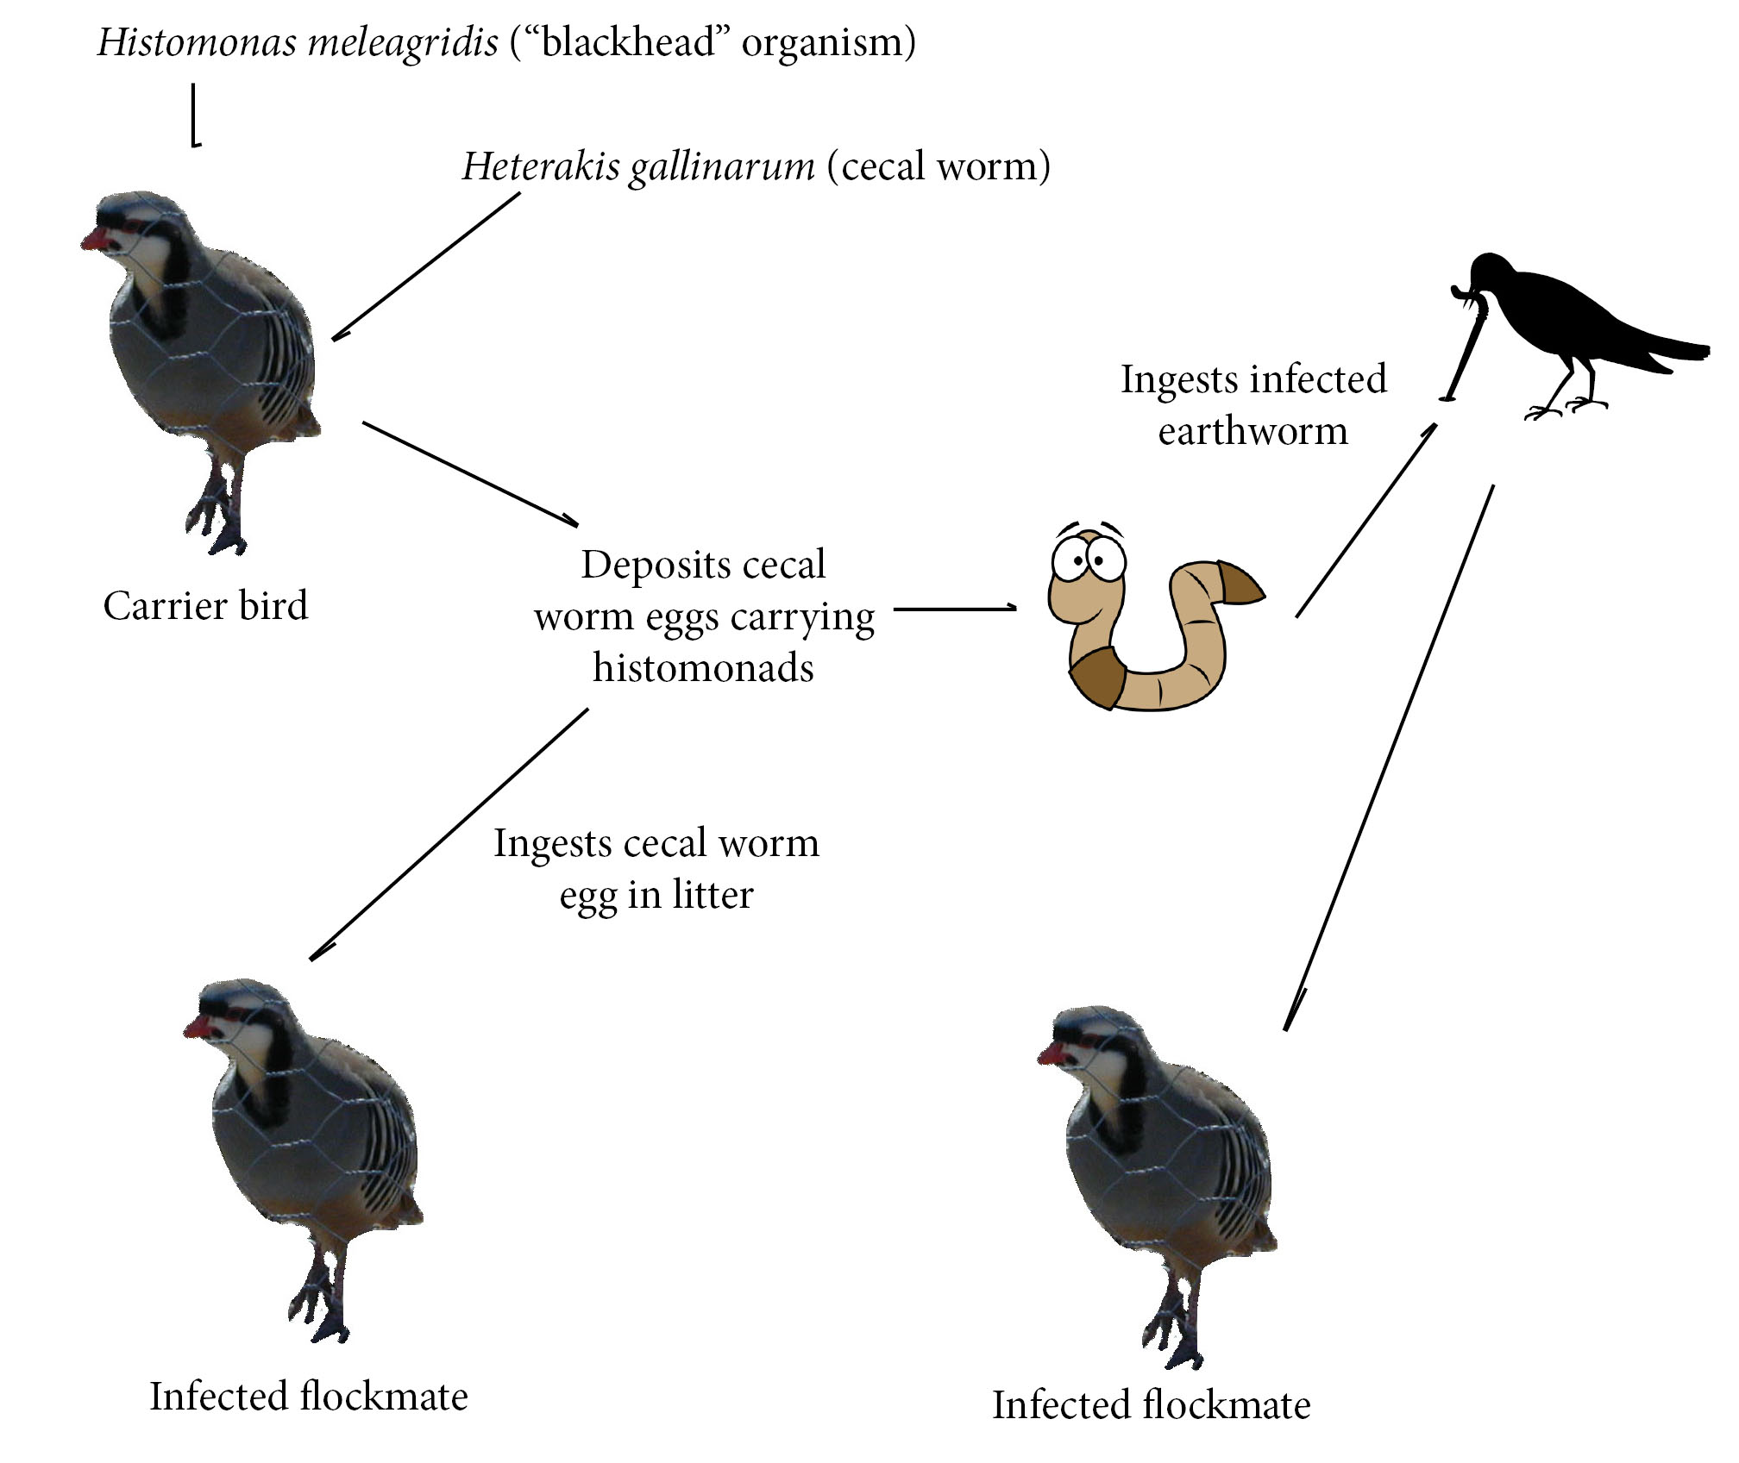
Histomoniasis (Blackhead)

Slide 23
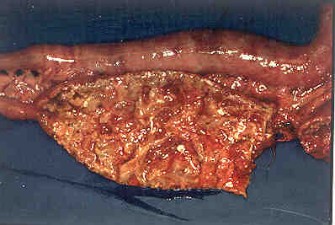
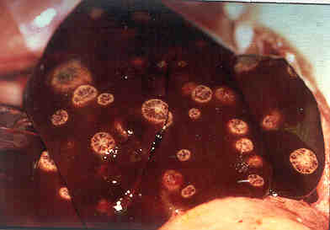

Slide 24
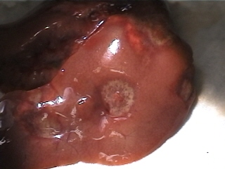
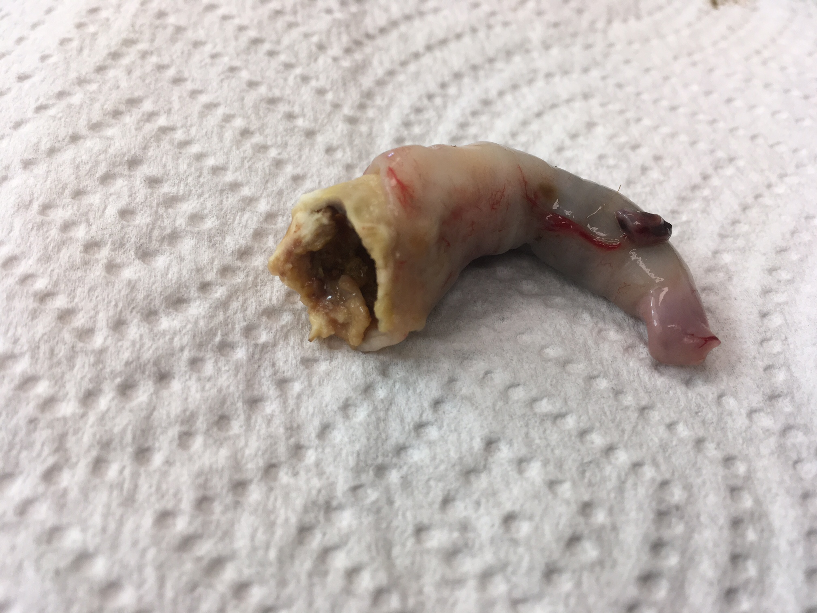
Histomoniasis (Blackhead)

Slide 25
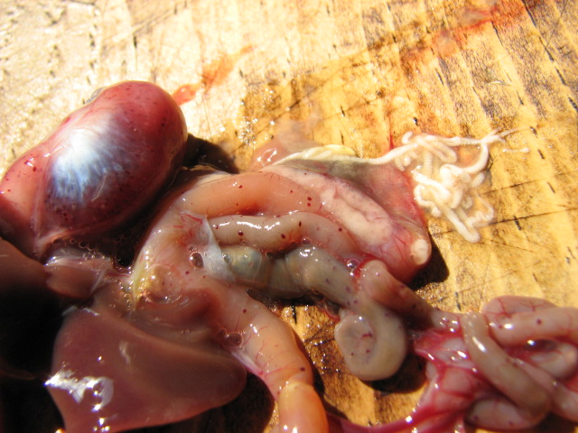
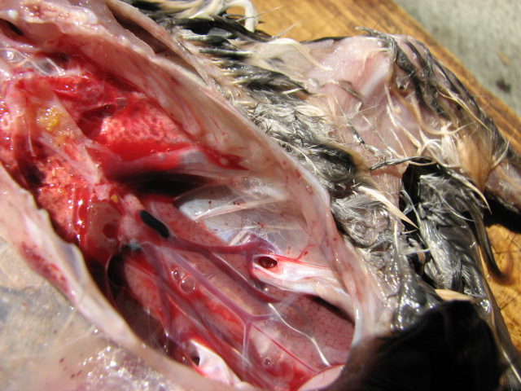
Haemoproteus – Bobwhite Quail

Slide 26
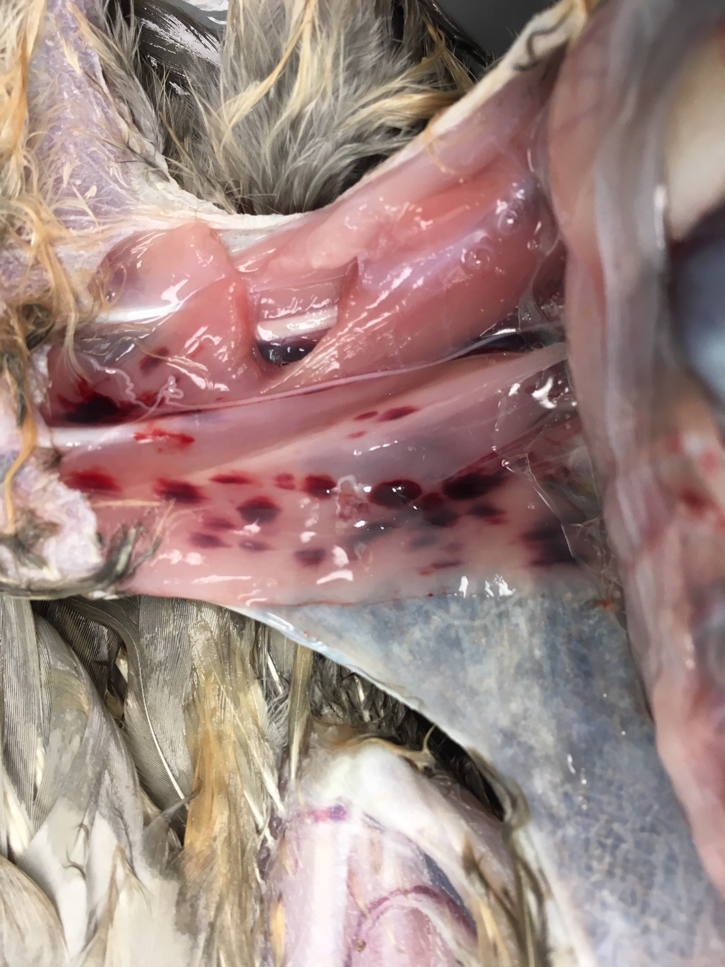

Slide 27
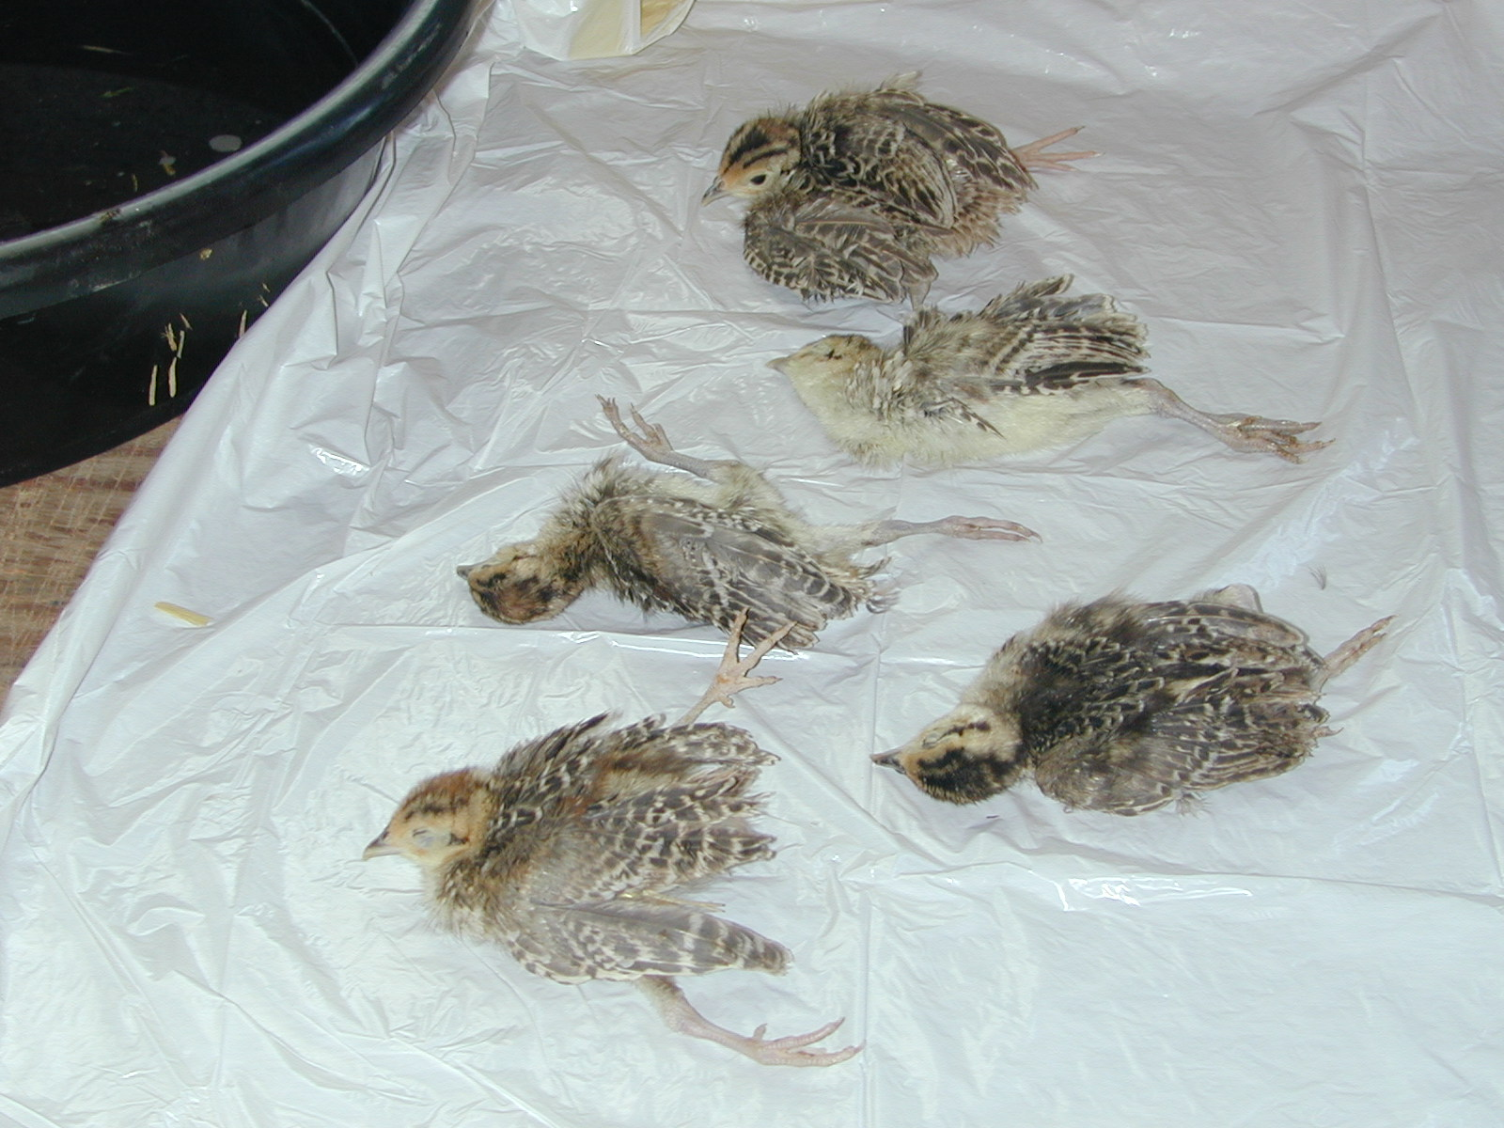
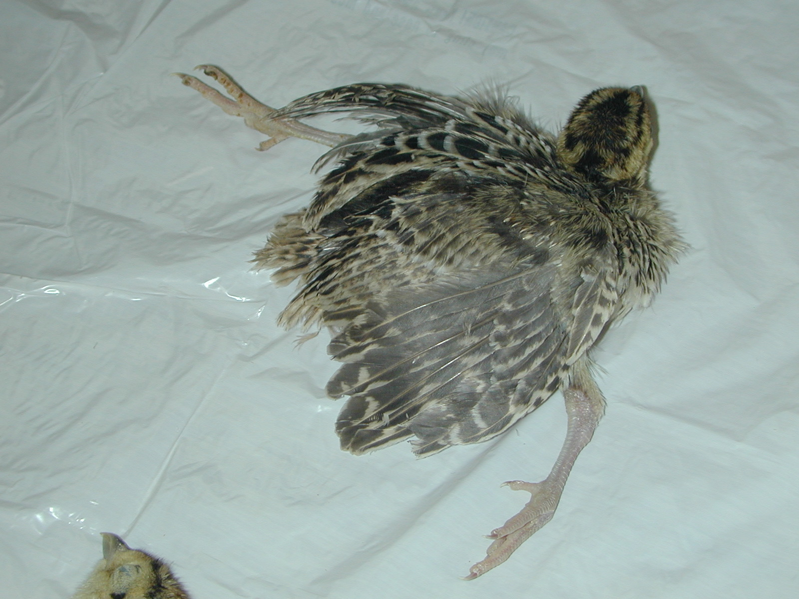
Vitamin/Mineral Deficiencies

Slide 29
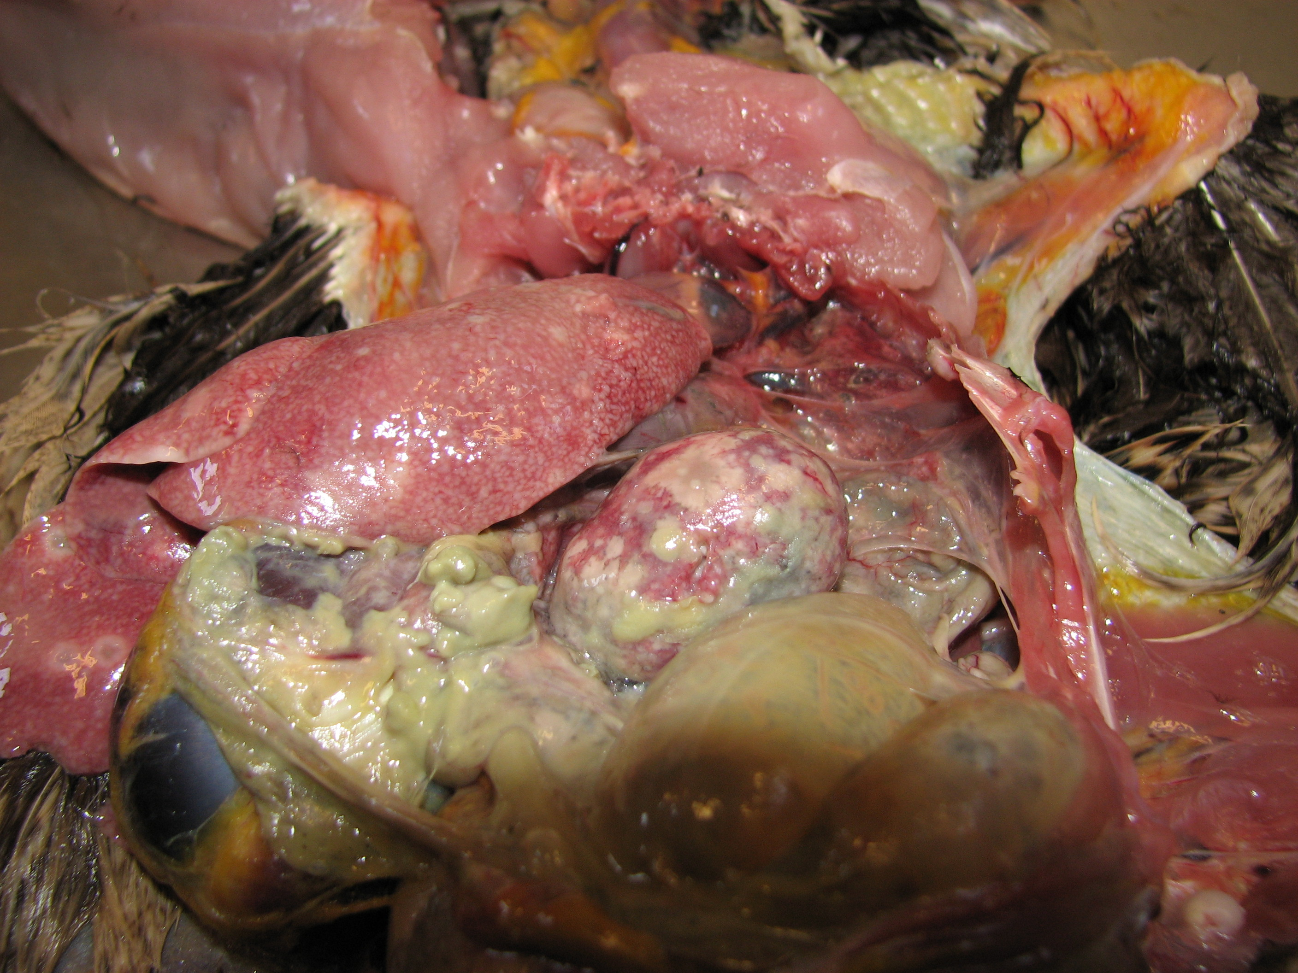
Avian Tuberculosis

Slide 30
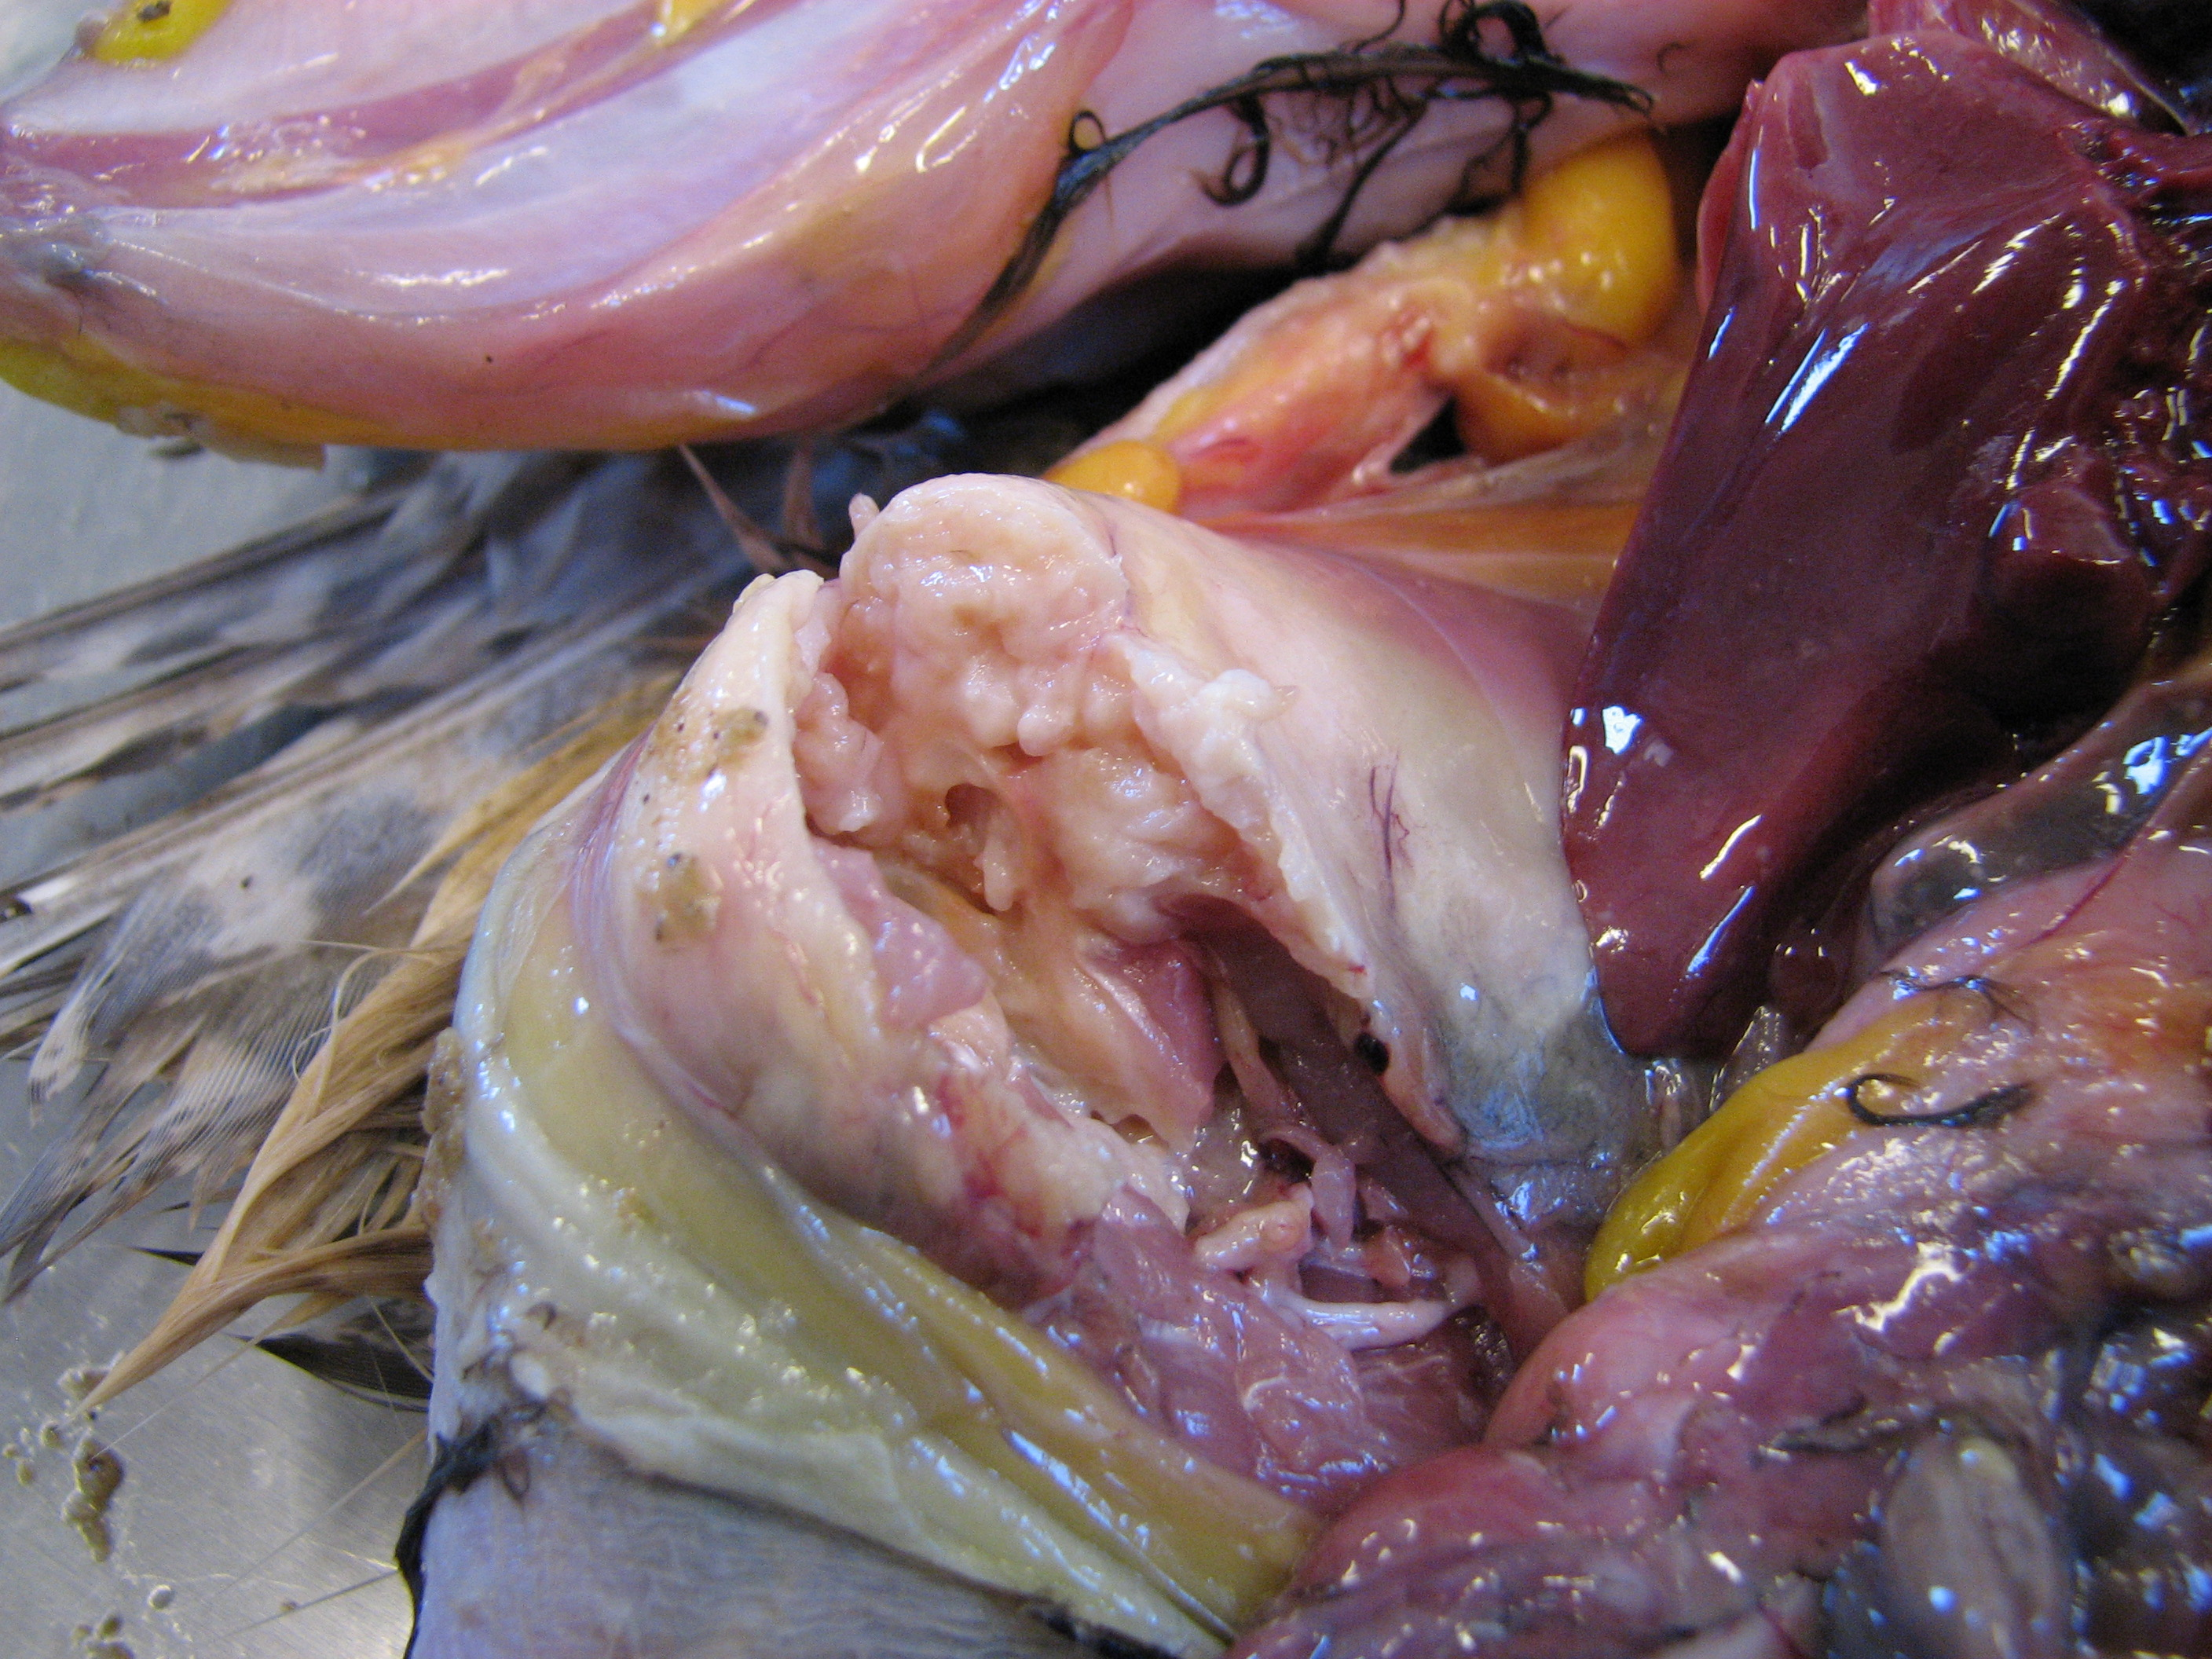

Slide 31
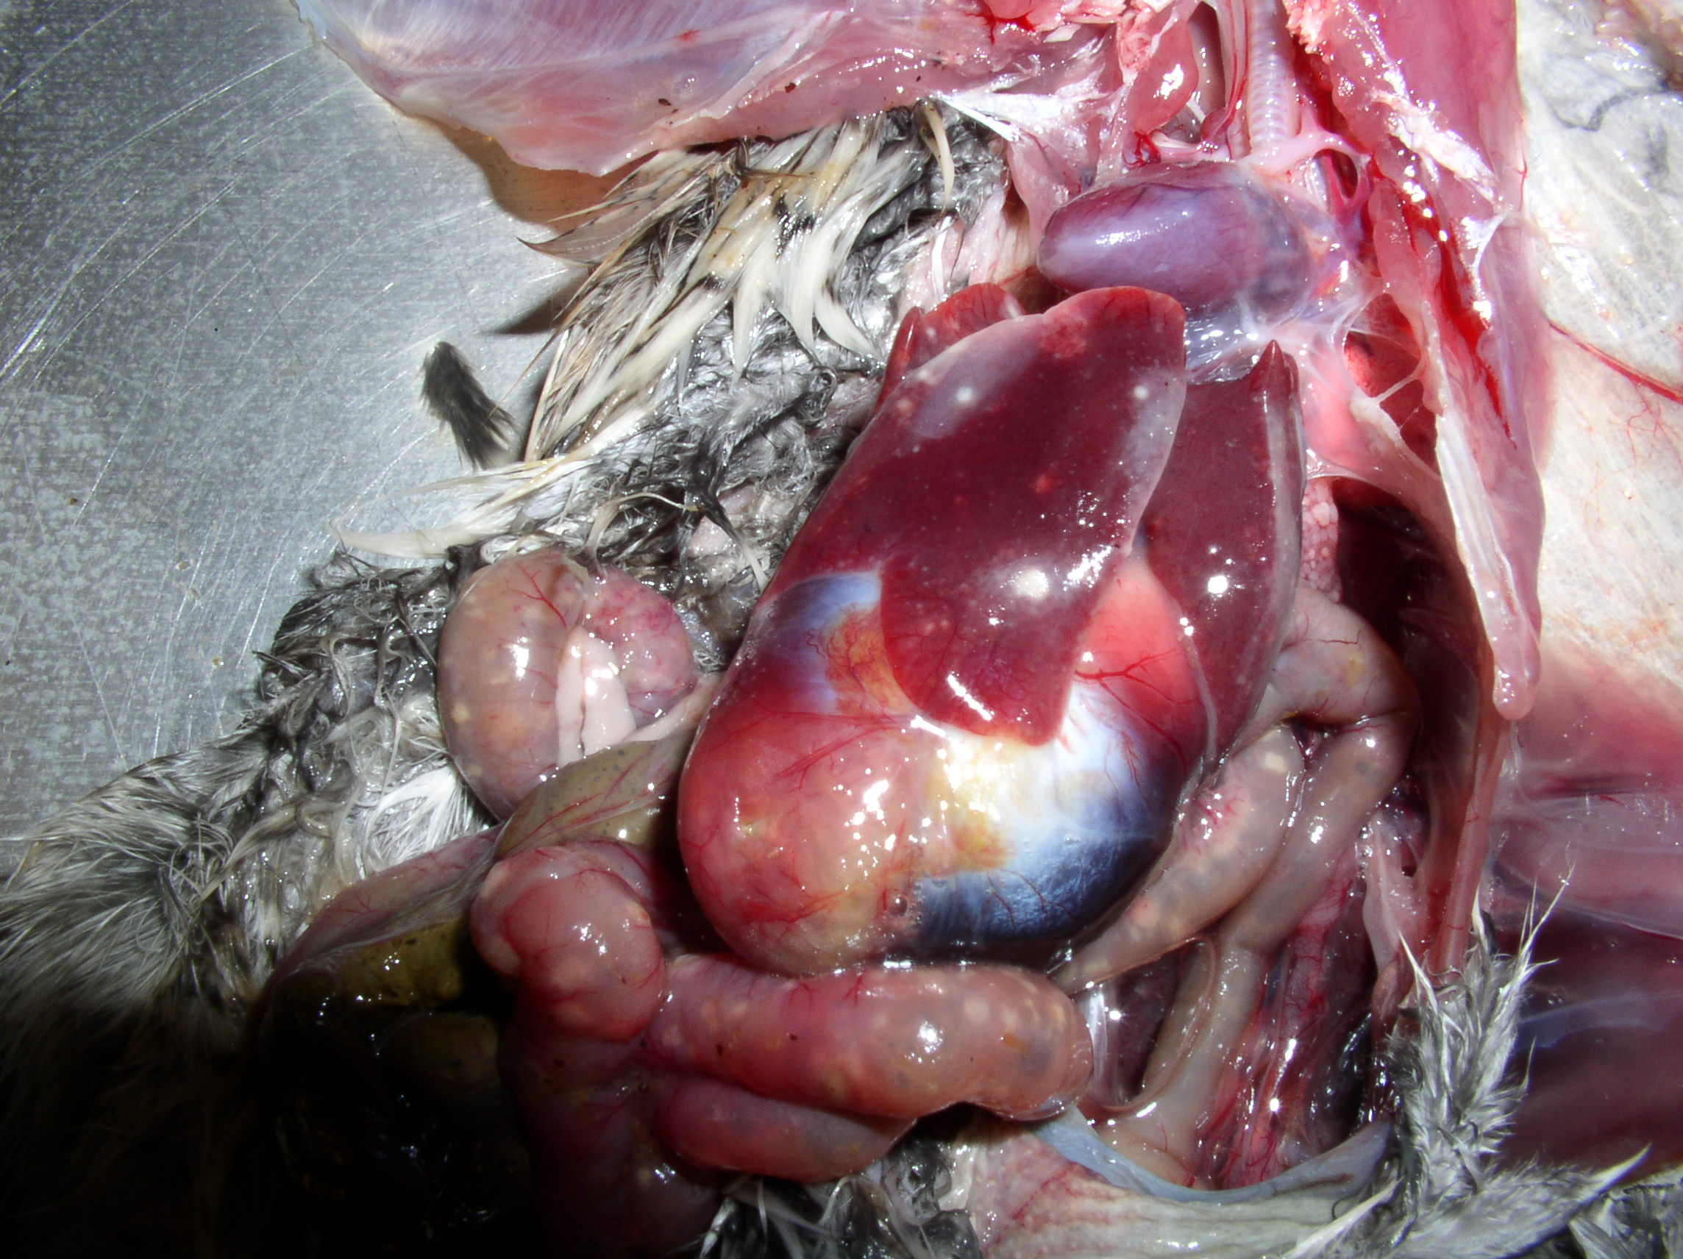
Ulcerative Enteritis

Slide 32
